Slide 1


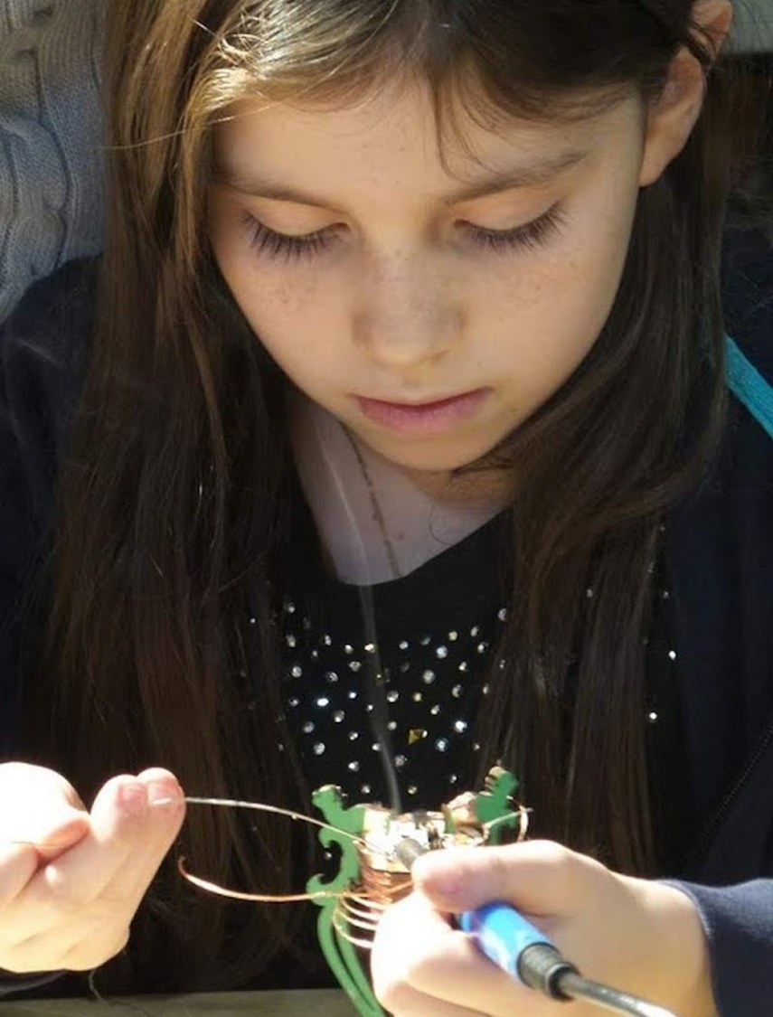



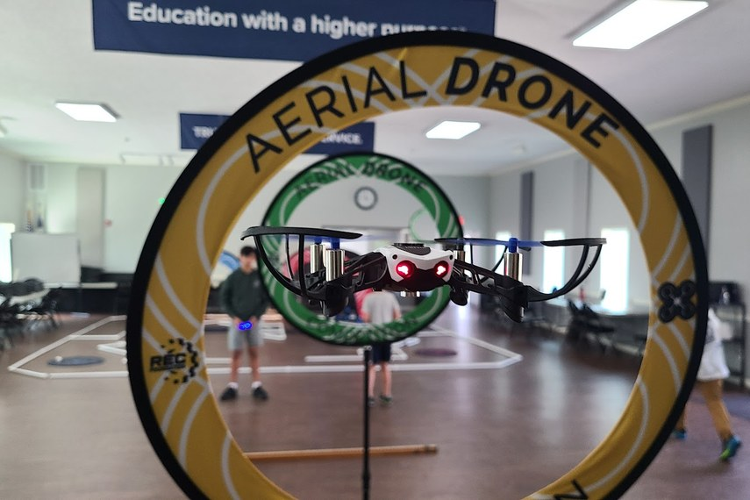

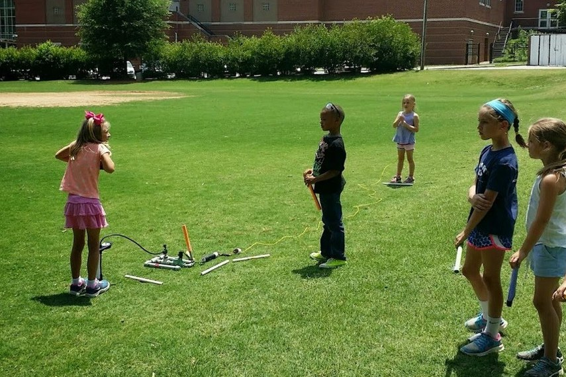
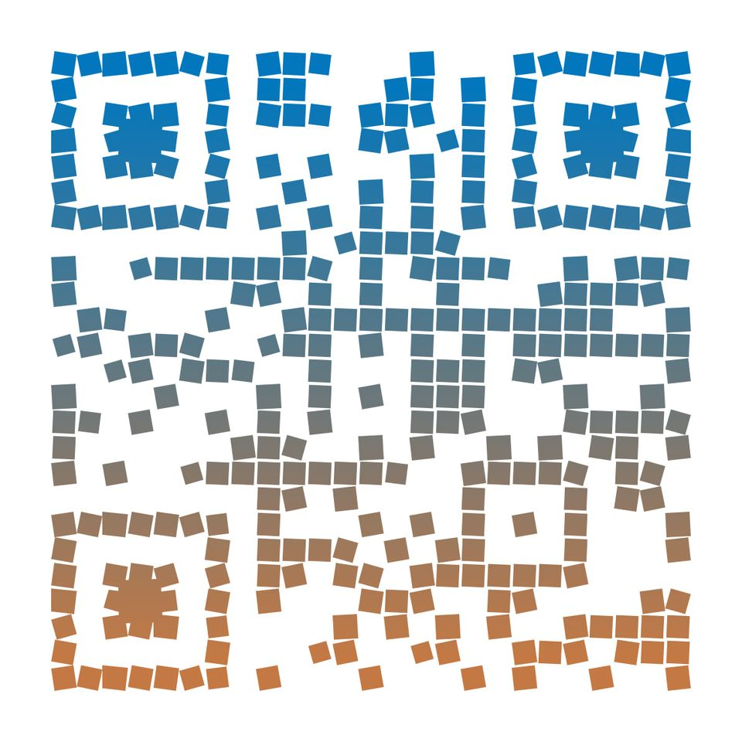
Book a Session
MakerLabKids.com
info@MakerLabKids.com
Service Area
Metro Atlanta & surrounding areas
Cultivating curiosity, critical thinking, and creative confidence in our young scholars.
Free travel within 30 miles
Mobile STEM Workshops
Perfect For
"The kids always love it when Quincy comes to our school. His love of science is contagious."
- Mr. Ted, Parker-Chase Sprayberry
Schools & Daycares
An in-house field trip!
We bring hands-on science to your school. Every kid builds. Every kid takes it home.
Afterschool Programs
Scout Troops & Summer Camps
Scan to learn more
MakerLabKids.com

Slide 2




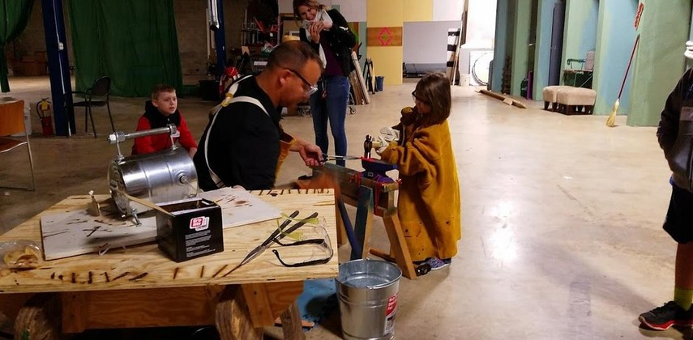
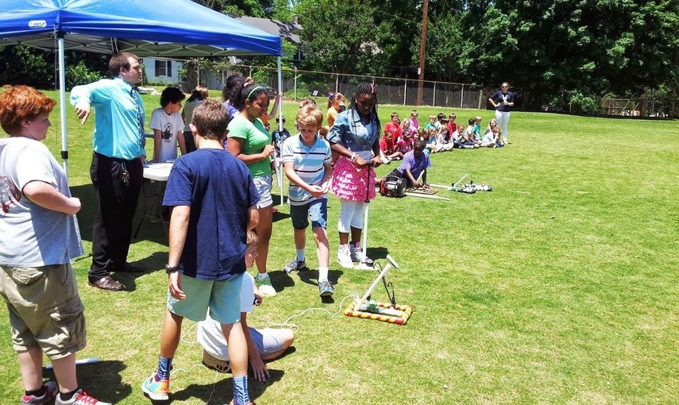


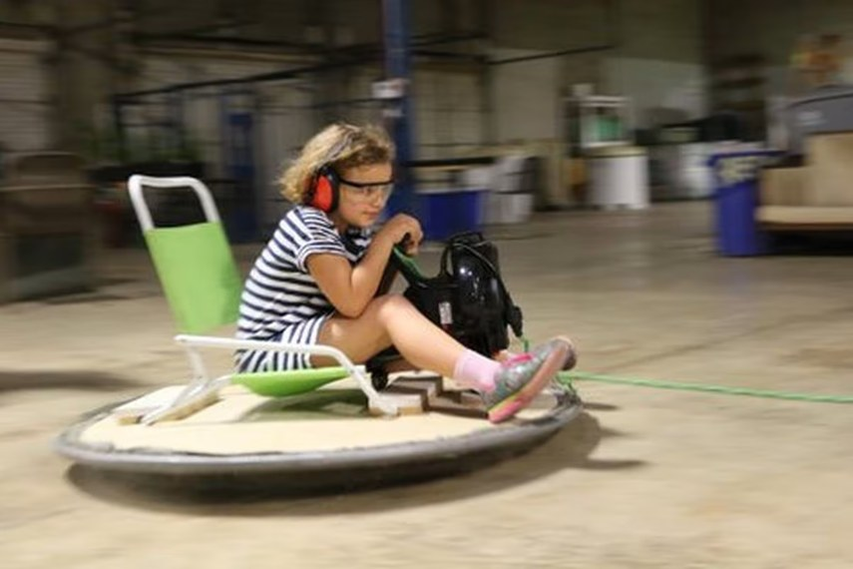
⭐ FLAGSHIP PROGRAM
Why Schools Choose Us
More Than Rockets
🚀 Compressed Air Rockets
🚌
We Come to You
No buses needed. An in-house field trip!
These aren't your average rockets - they soar HUNDREDS of feet into the sky! Real engineering meets pure excitement.
🛠
Everything Included
All equipment, materials, and supplies provided.
🎯
Every Kid Participates
100% hands-on. Every student builds their own project.
💡
Electronics & Soldering
Build LED projects, radios, and Arduino gadgets.
🤖
Drones & Robots
Drone flying, brush bots, and robot camps.
🎁
Take It Home
Students keep what they make.
🔥
Fire & Forge
Real blacksmithing and metal casting.
✓ Ages 4+ | Up to 25 students per session
✓ 45-75 minutes depending on age
✓ Build custom fins & nose cones
✓ Compete for distance & accuracy
✓ Every student takes their rocket home
Digital Fabrication
3D printing and CAD design.
⭐
Experienced Instructors
Led by makers who've coached robotics, drone, and cyber teams to national and world championships.
💻
🔒
Cybersecurity
Ethical hacking, lockpicking, CyberPatriot.
📚
Curriculum Aligned
Supports STEM and NGSS standards.
🎉
Special Events
Perfect for birthdays and special occasions!
from $400 per session
Multi-Session Savings (Same Day)
Large group and multi-session discounts available. Contact us to learn more.
Ready to Launch?
MakerLabKids.com

