Slide 1





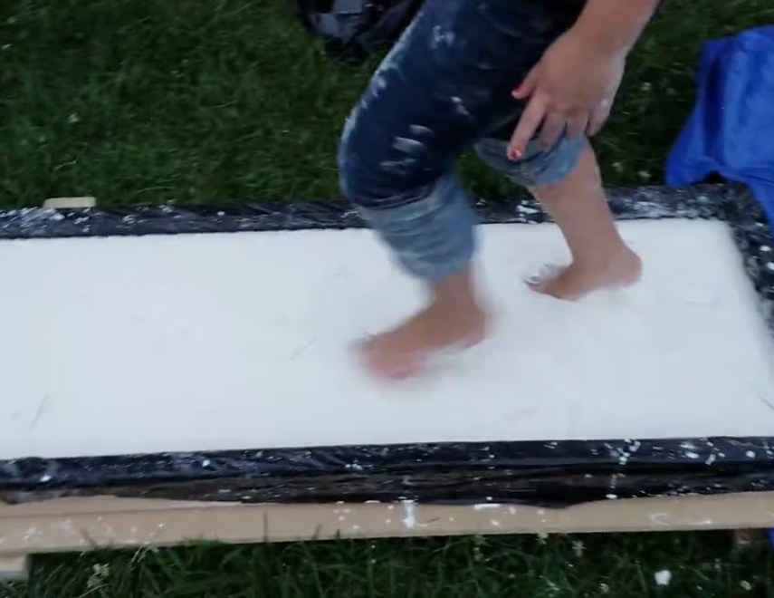


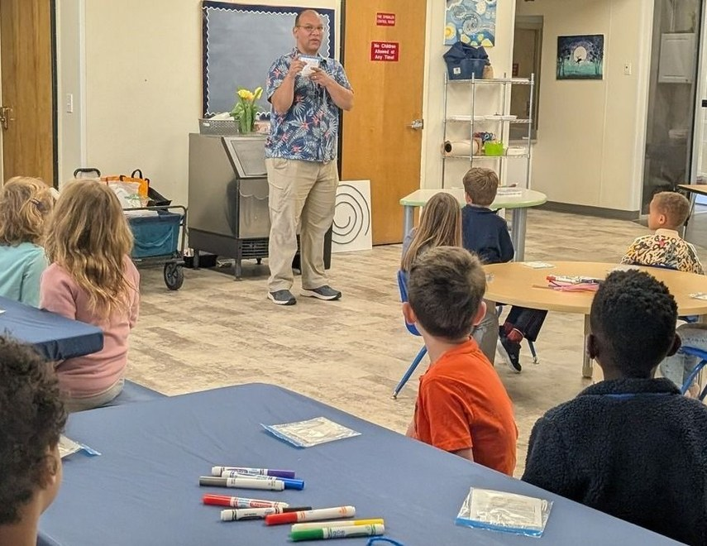

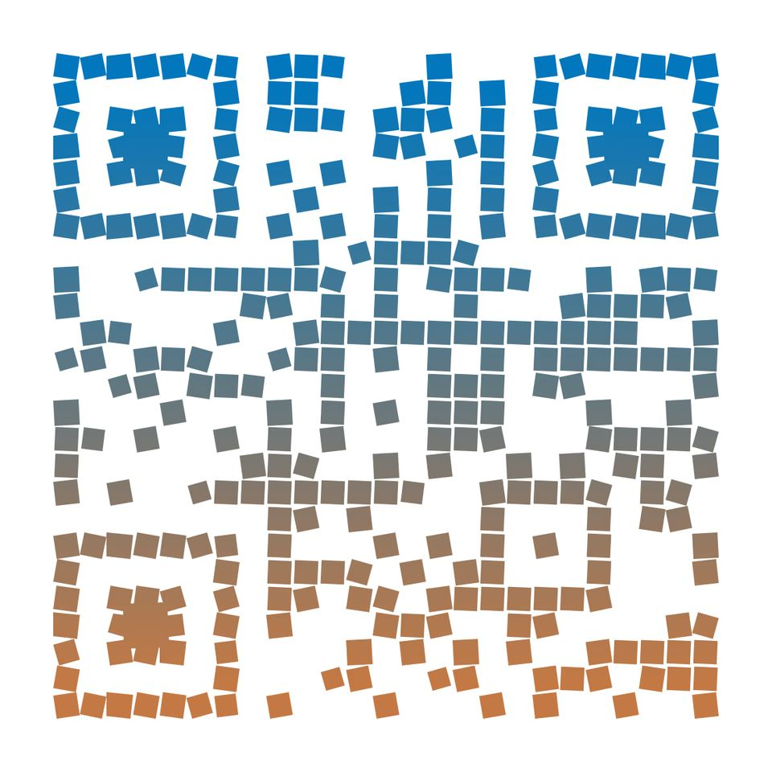
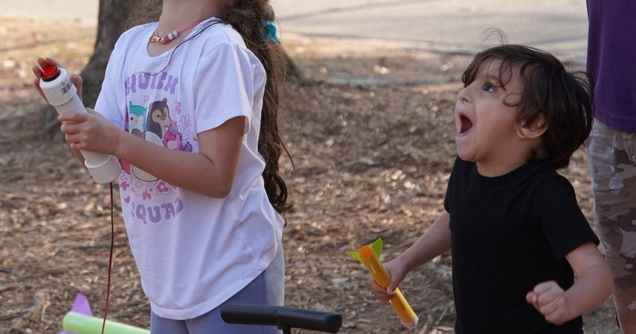
Designed for Little Learners
Book a Session
MakerLabKids.com
info@MakerLabKids.com
Service Area
"The kids always love it when Quincy comes to our school. His love of science is contagious."
- Mr. Ted, Parker-Chase Sprayberry
Metro Atlanta & surrounding areas
Sparking curiosity and wonder in our youngest scholars through hands-on science adventures.
Free travel within 30 miles
Mobile STEM Workshops
Perfect For
Ages 4 & 5
Preschools & Daycares
Pre-K & Kindergarten Programs
An in-house field trip!
We bring hands-on science right to your classroom. Every child explores. Every child discovers. Every child takes something home.
Summer Camps
Scan to learn more
MakerLabKids.com

Slide 2



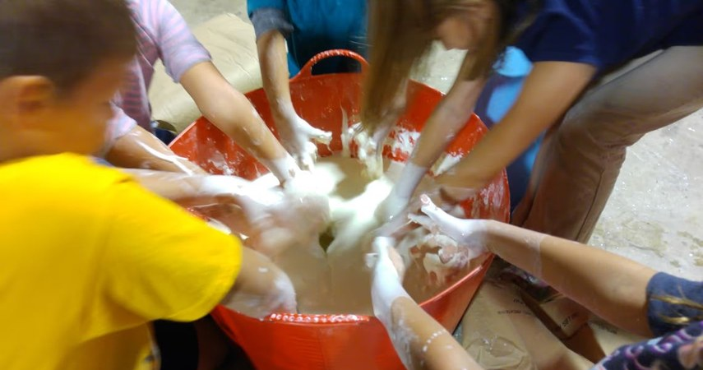
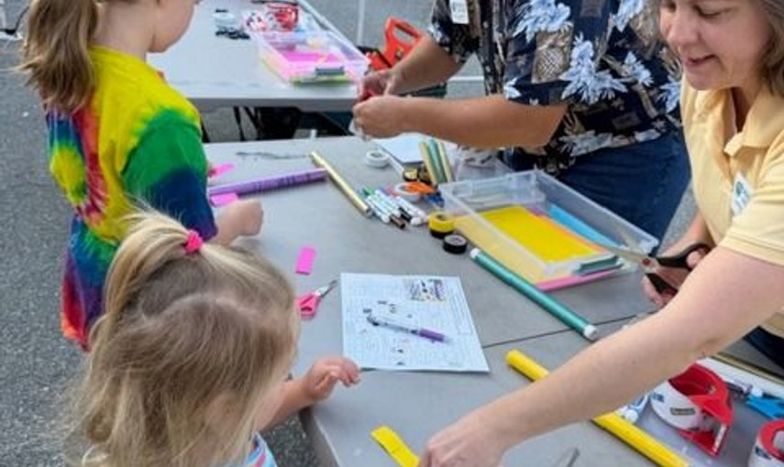



⭐ FLAGSHIP PROGRAM
Why Schools Choose Us
🔬 Science & Discovery
🚀 Compressed Air Rockets
🚌
We Come to You
No buses, no permission slips for off-site trips. We set up right in your space.
These rockets soar HUNDREDS of feet into the sky! Pure excitement with real engineering - sized just right for little hands.
🛠
Everything Included
All equipment, materials, and supplies provided. Zero prep for teachers.
🎯
Every Kid Participates
100% hands-on. No watching from the side - every child builds their own project.
💧 Oobleck Adventure
Is it a liquid or a solid? BOTH! Mix oobleck, watch it dance on a speaker, then run across a giant trough of it!
🎁
Take It Home
Students keep what they make. A real souvenir from a real experience.
Ages 4-7
60 min
Up to 20 kids
$500
✓ Ages 4-8 | Up to 15 students per session
✓ 75 minutes with extra 1-on-1 support
✓ Decorate with stickers, markers & tape
✓ Launch and watch them FLY!
✓ Every child takes their rocket home
🧲 Magnet Explorers
🧐
Age-Appropriate
Programs designed specifically for 4 and 5 year olds with extra support and guidance.
Discover the invisible force! Build an electromagnet, play with floating magnets, and explore ferrofluid.
Ages 4-7
60 min
Up to 20 kids
$500
📚
Standards Aligned
Supports Georgia Early Learning Standards and NGSS.
🩹 Sound Detectives
Build a real stethoscope from recycled materials and 3D printed parts, then solve sound mysteries!
from $400 per session
Ages 4-5
60 min
Up to 20 kids
$500
Built for the Littles
Smaller groups and longer sessions mean more hands-on help for every child. Our instructors are experienced with Pre-K and kindergarten learners.
Ready to Explore?
⭐ Book Multiple Programs & Save!
Same-day multi-session discounts available. Mix and match rockets with any science program for a full day of discovery!
MakerLabKids.com

