Slide 1



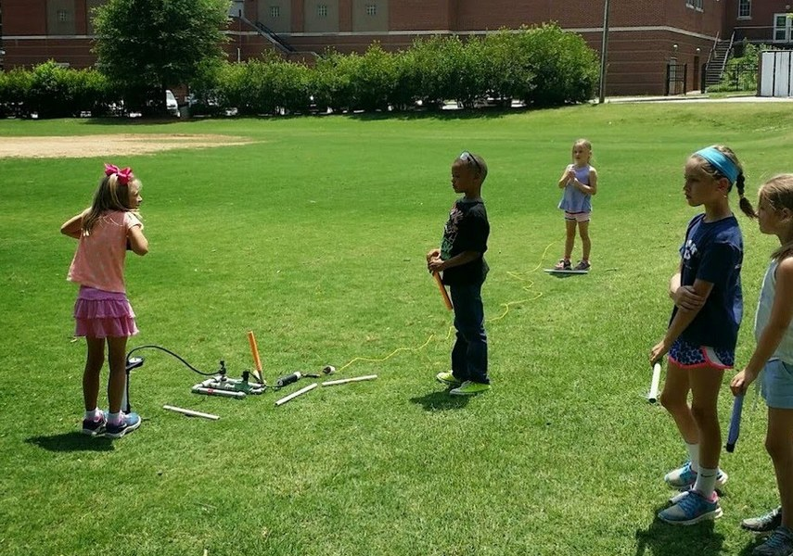
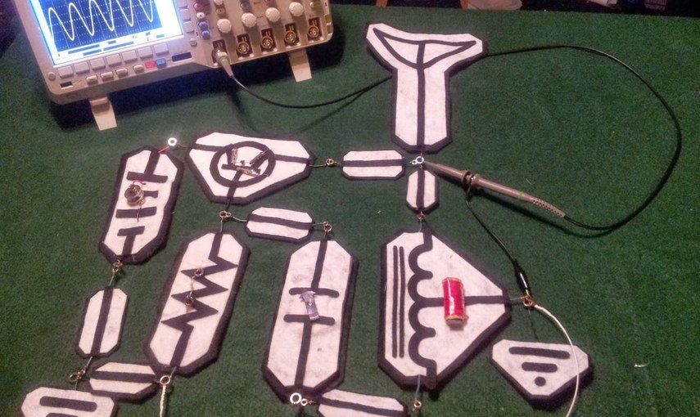


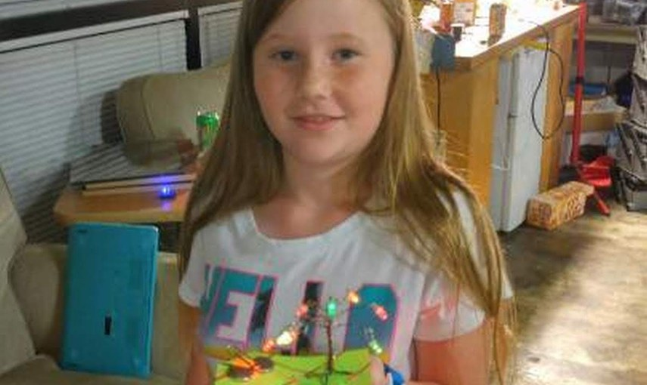
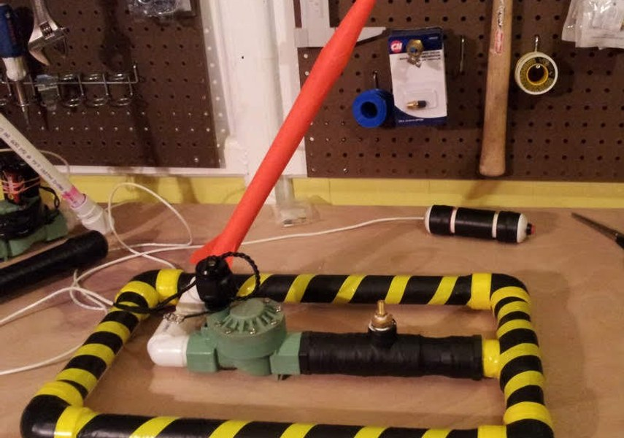

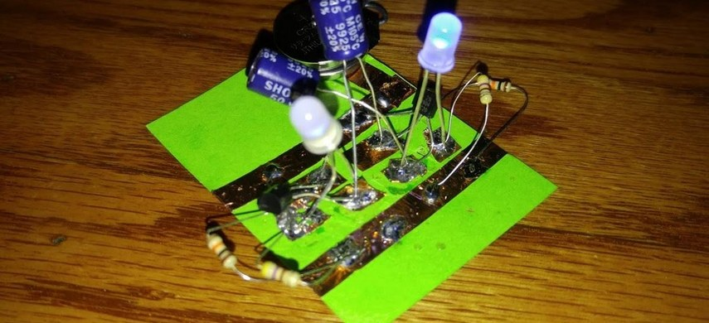
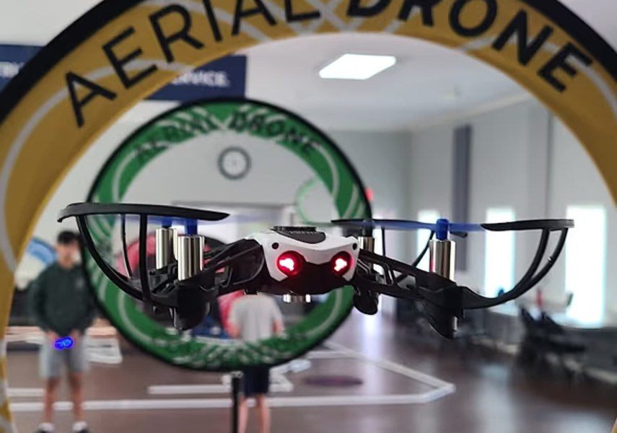
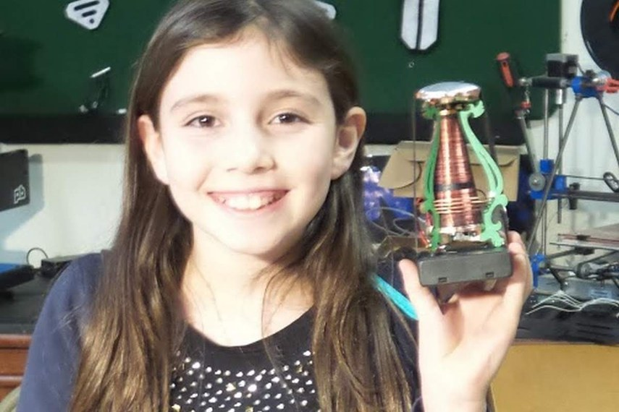
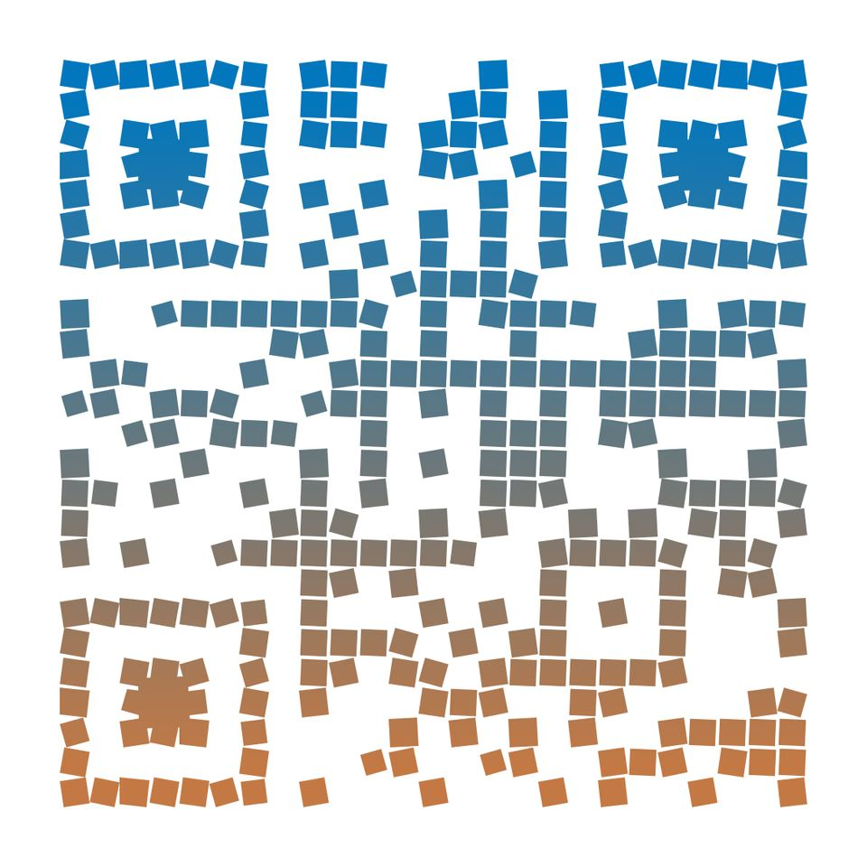
Rockets & Drones
Electronics & Soldering
4. Build a Working Radio
1. Compressed Air Rockets
Cultivating curiosity, critical thinking, and creative confidence in our young scholars.
Mobile STEM Workshops
5. LED Projects
An in-house field trip!
We bring hands-on science to your school. Every kid builds. Every kid takes it home.
2. Every kid builds & launches!
6. Real Soldering Skills
3. Drone Pilot Training
MakerLabKids.com

Slide 2


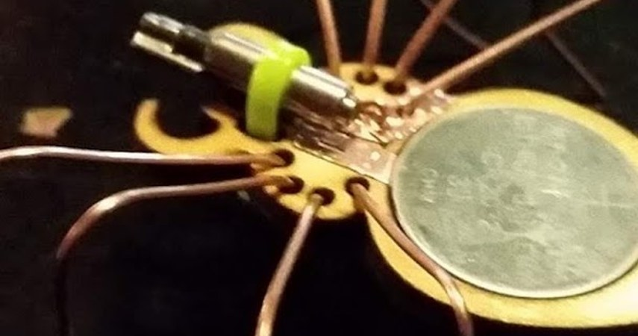
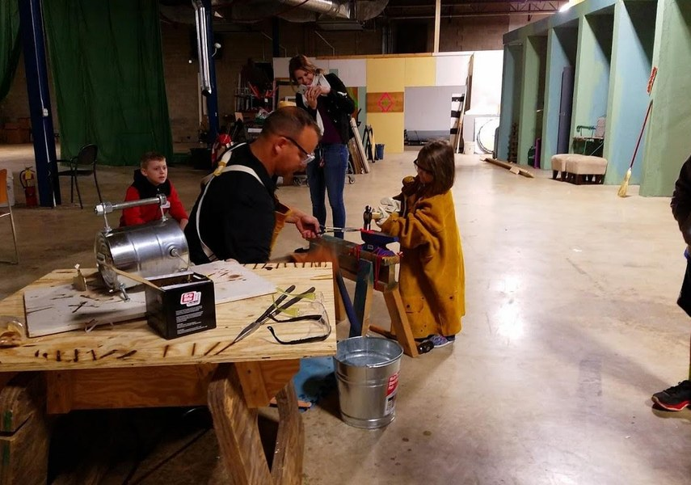
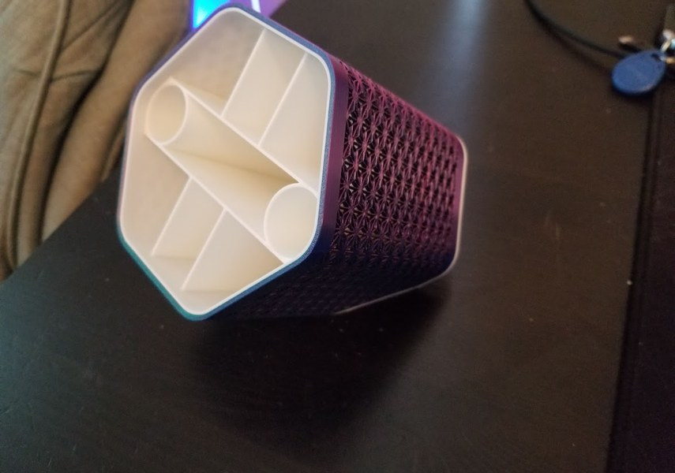
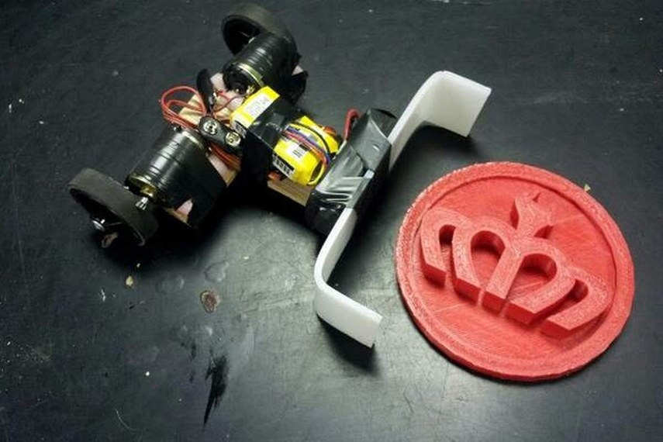
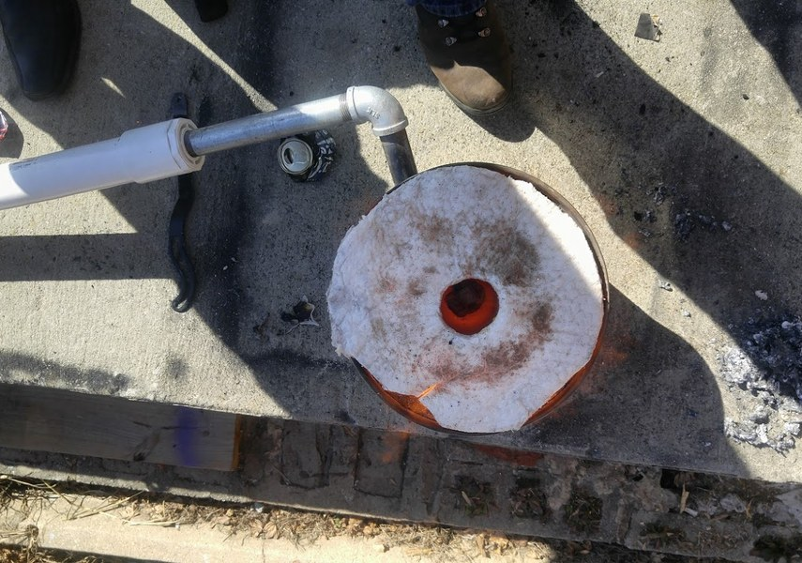
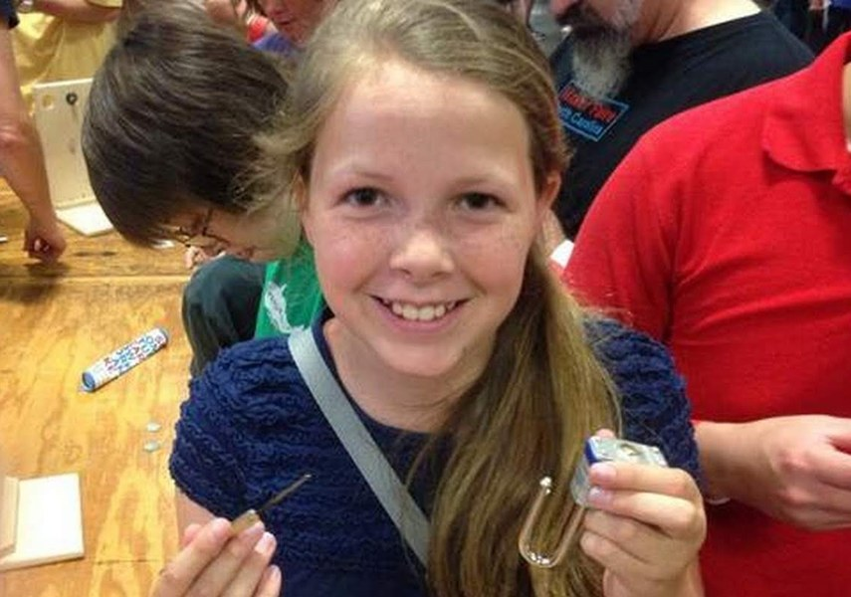
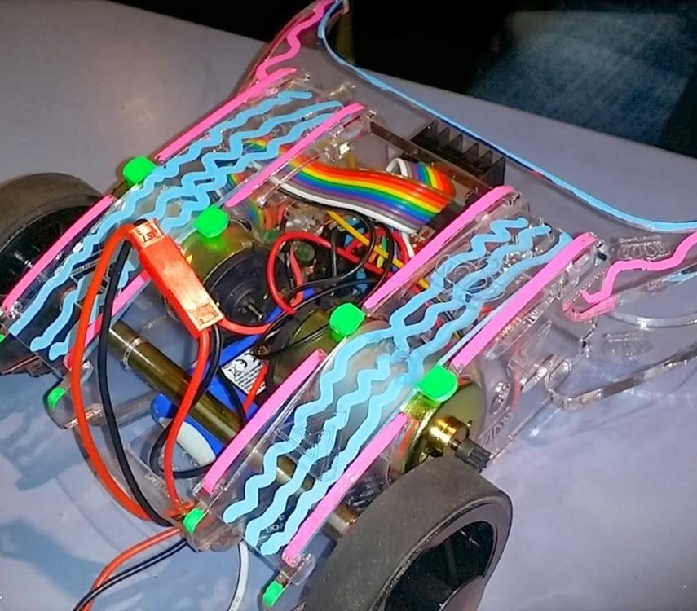
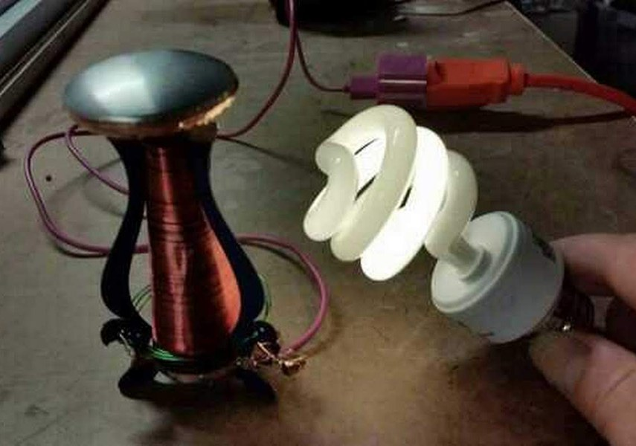
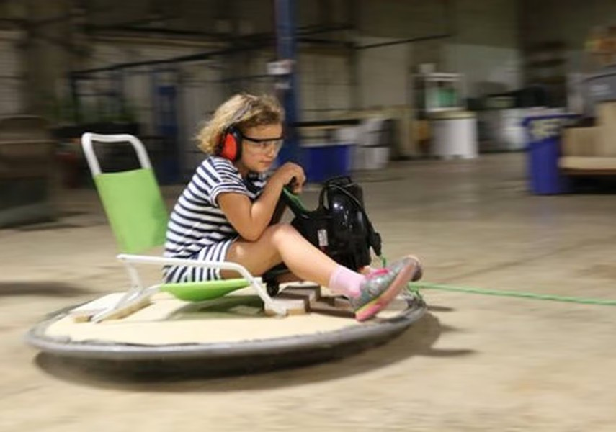
Robotics
Fire & Forge
And More!
7. Brush Bots
10. Real Blacksmithing
13. 3D Printing & CAD
8. Arduino Robots
11. Metal Casting
14. Cybersecurity & Lock Picking
9. Battle Bots
12. Tesla Coils
15. Special Events & Parties

