Slide 1


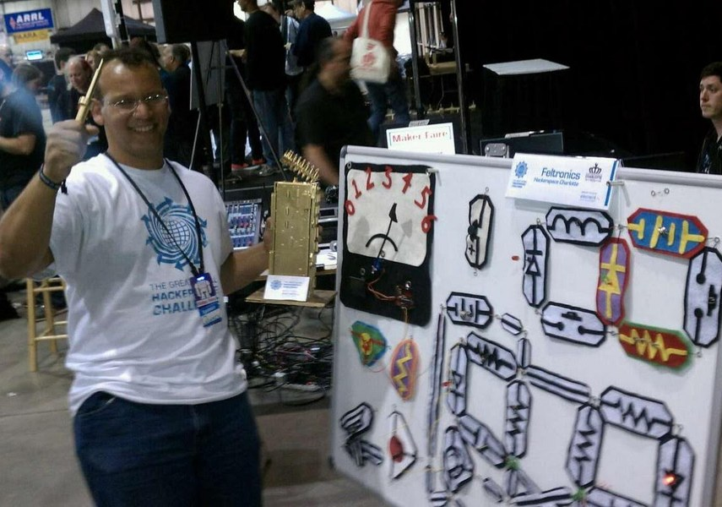

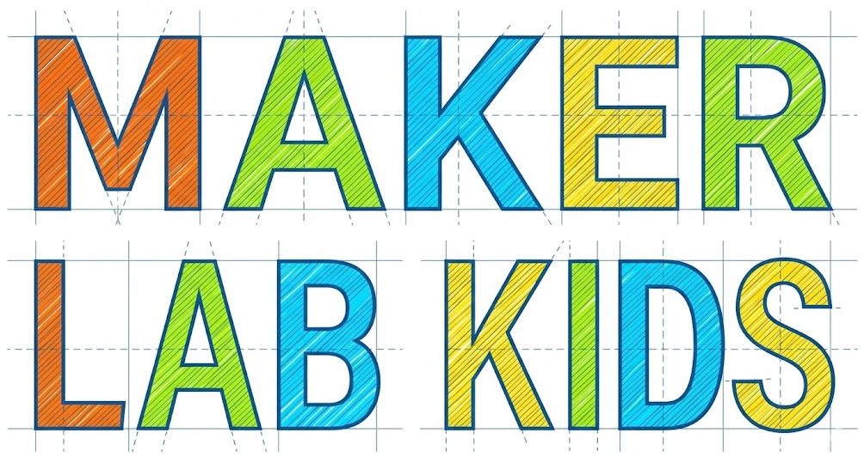

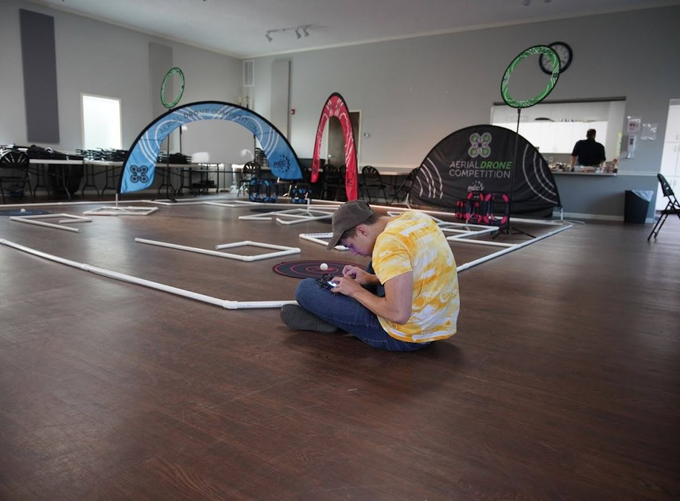

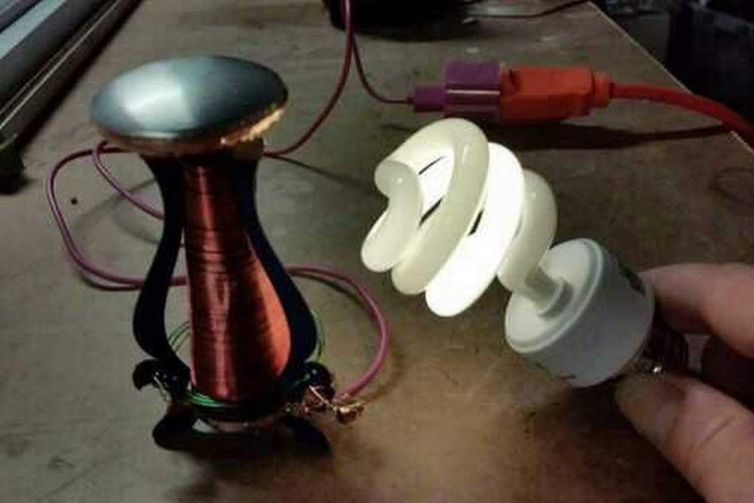
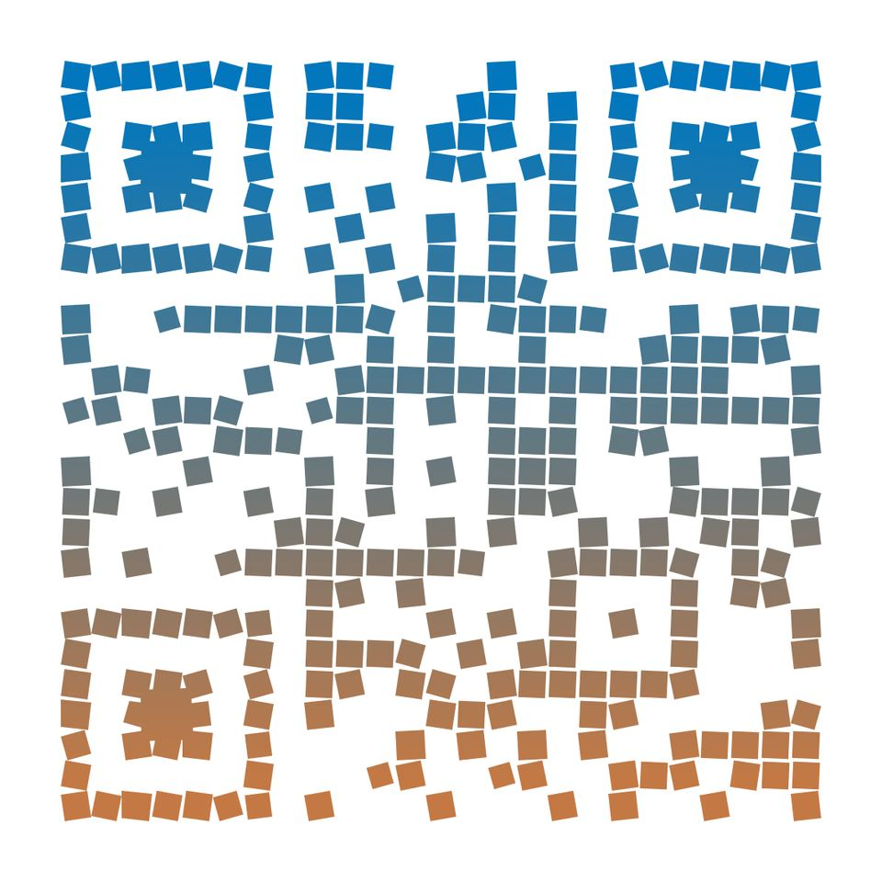
Book a Session
MakerLabKids.com
Competition-Proven Coaching
Our instructors have coached robotics, drone, and cyber teams to national and world championships - and bring that same rigor to every workshop.
info@MakerLabKids.com
Service Area
Metro Atlanta & surrounding areas
Real engineering. Real skills. College and career ready.
Free travel within 30 miles
Advanced STEM for High Schools
Built For
High School STEM classes
Beyond the textbook.
Soldering irons, drones, oscilloscopes, ethical hacking, CNC, metal casting - the hands-on engineering that makes STEM stick.
AP & CTE pathways
Competition teams & clubs
Scan to learn more
MakerLabKids.com

Slide 2




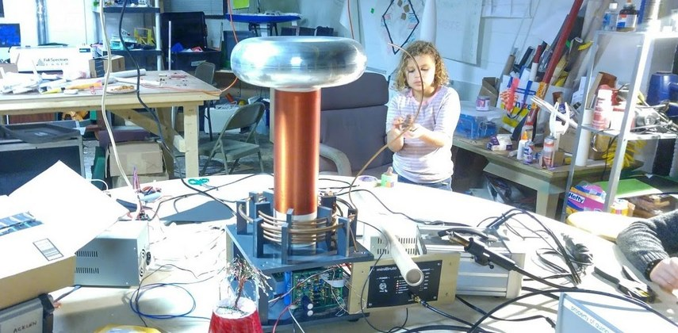
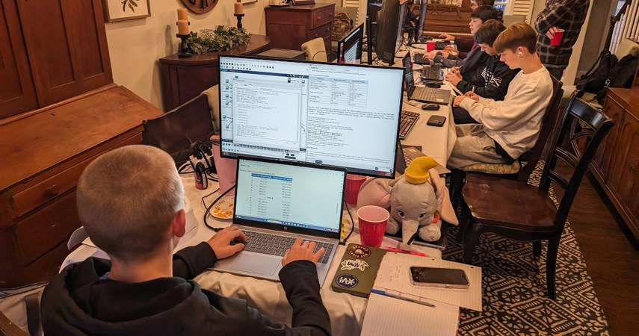


🎖 FLAGSHIP PROGRAM
Why High Schools Choose Us
Advanced Workshops
🔒 Cybersecurity & AP Prep
🏆
Championship Coaching
Makers who've coached robotics, drone, and cyber teams to national and world titles.
Hands-on workshops mapped to the new AP Cybersecurity framework - five units, three spiraled skills: Analyze, Mitigate, Detect.
🛠
Real Maker Gear
Soldering irons, oscilloscopes, CAD, drones, 3D printers, forges. Real tools, not classroom toys.
⚡
Tesla Coil & SMT Soldering
High-voltage physics plus surface-mount soldering skills.
🎓
College & Career Ready
Builds portfolio-worthy projects that strengthen college apps and CTE certifications.
🕸
Drone Pilot Training
Flight skills, airspace rules, and FAA Part 107 fundamentals.
✓ Maps to all 5 AP units: Intro, Spaces, Networks, Devices, Apps & Data
✓ Hands-on: packet capture, password cracking, lockpicking, social engineering
✓ CyberPatriot competition prep available
✓ 90-minute single visit or multi-week series
📚
Standards Aligned
AP Cybersecurity units, CSTA, NGSS HS, and Georgia CTE engineering & cybersecurity pathways.
💻
Arduino & IoT
C/C++ on real microcontrollers. Sensors, actuators, data.
🛠
Digital Fabrication
3D printing, CAD, CNC routing. Design to finished part.
🚌
We Come to You
No field-trip logistics. All equipment, materials, and setup included.
🔥
Metal Casting & Forge
Aluminum casting and blacksmithing. Real metalwork.
from $400 per session
VEX Robotics Coaching
Team strategy, build, and program coaching for competition.
🤖
Competition-Proven
Led by a coach who has taken CyberPatriot, robotics, and drone teams to national and world championships.
Ready to Build?
MakerLabKids.com

