Slide 1

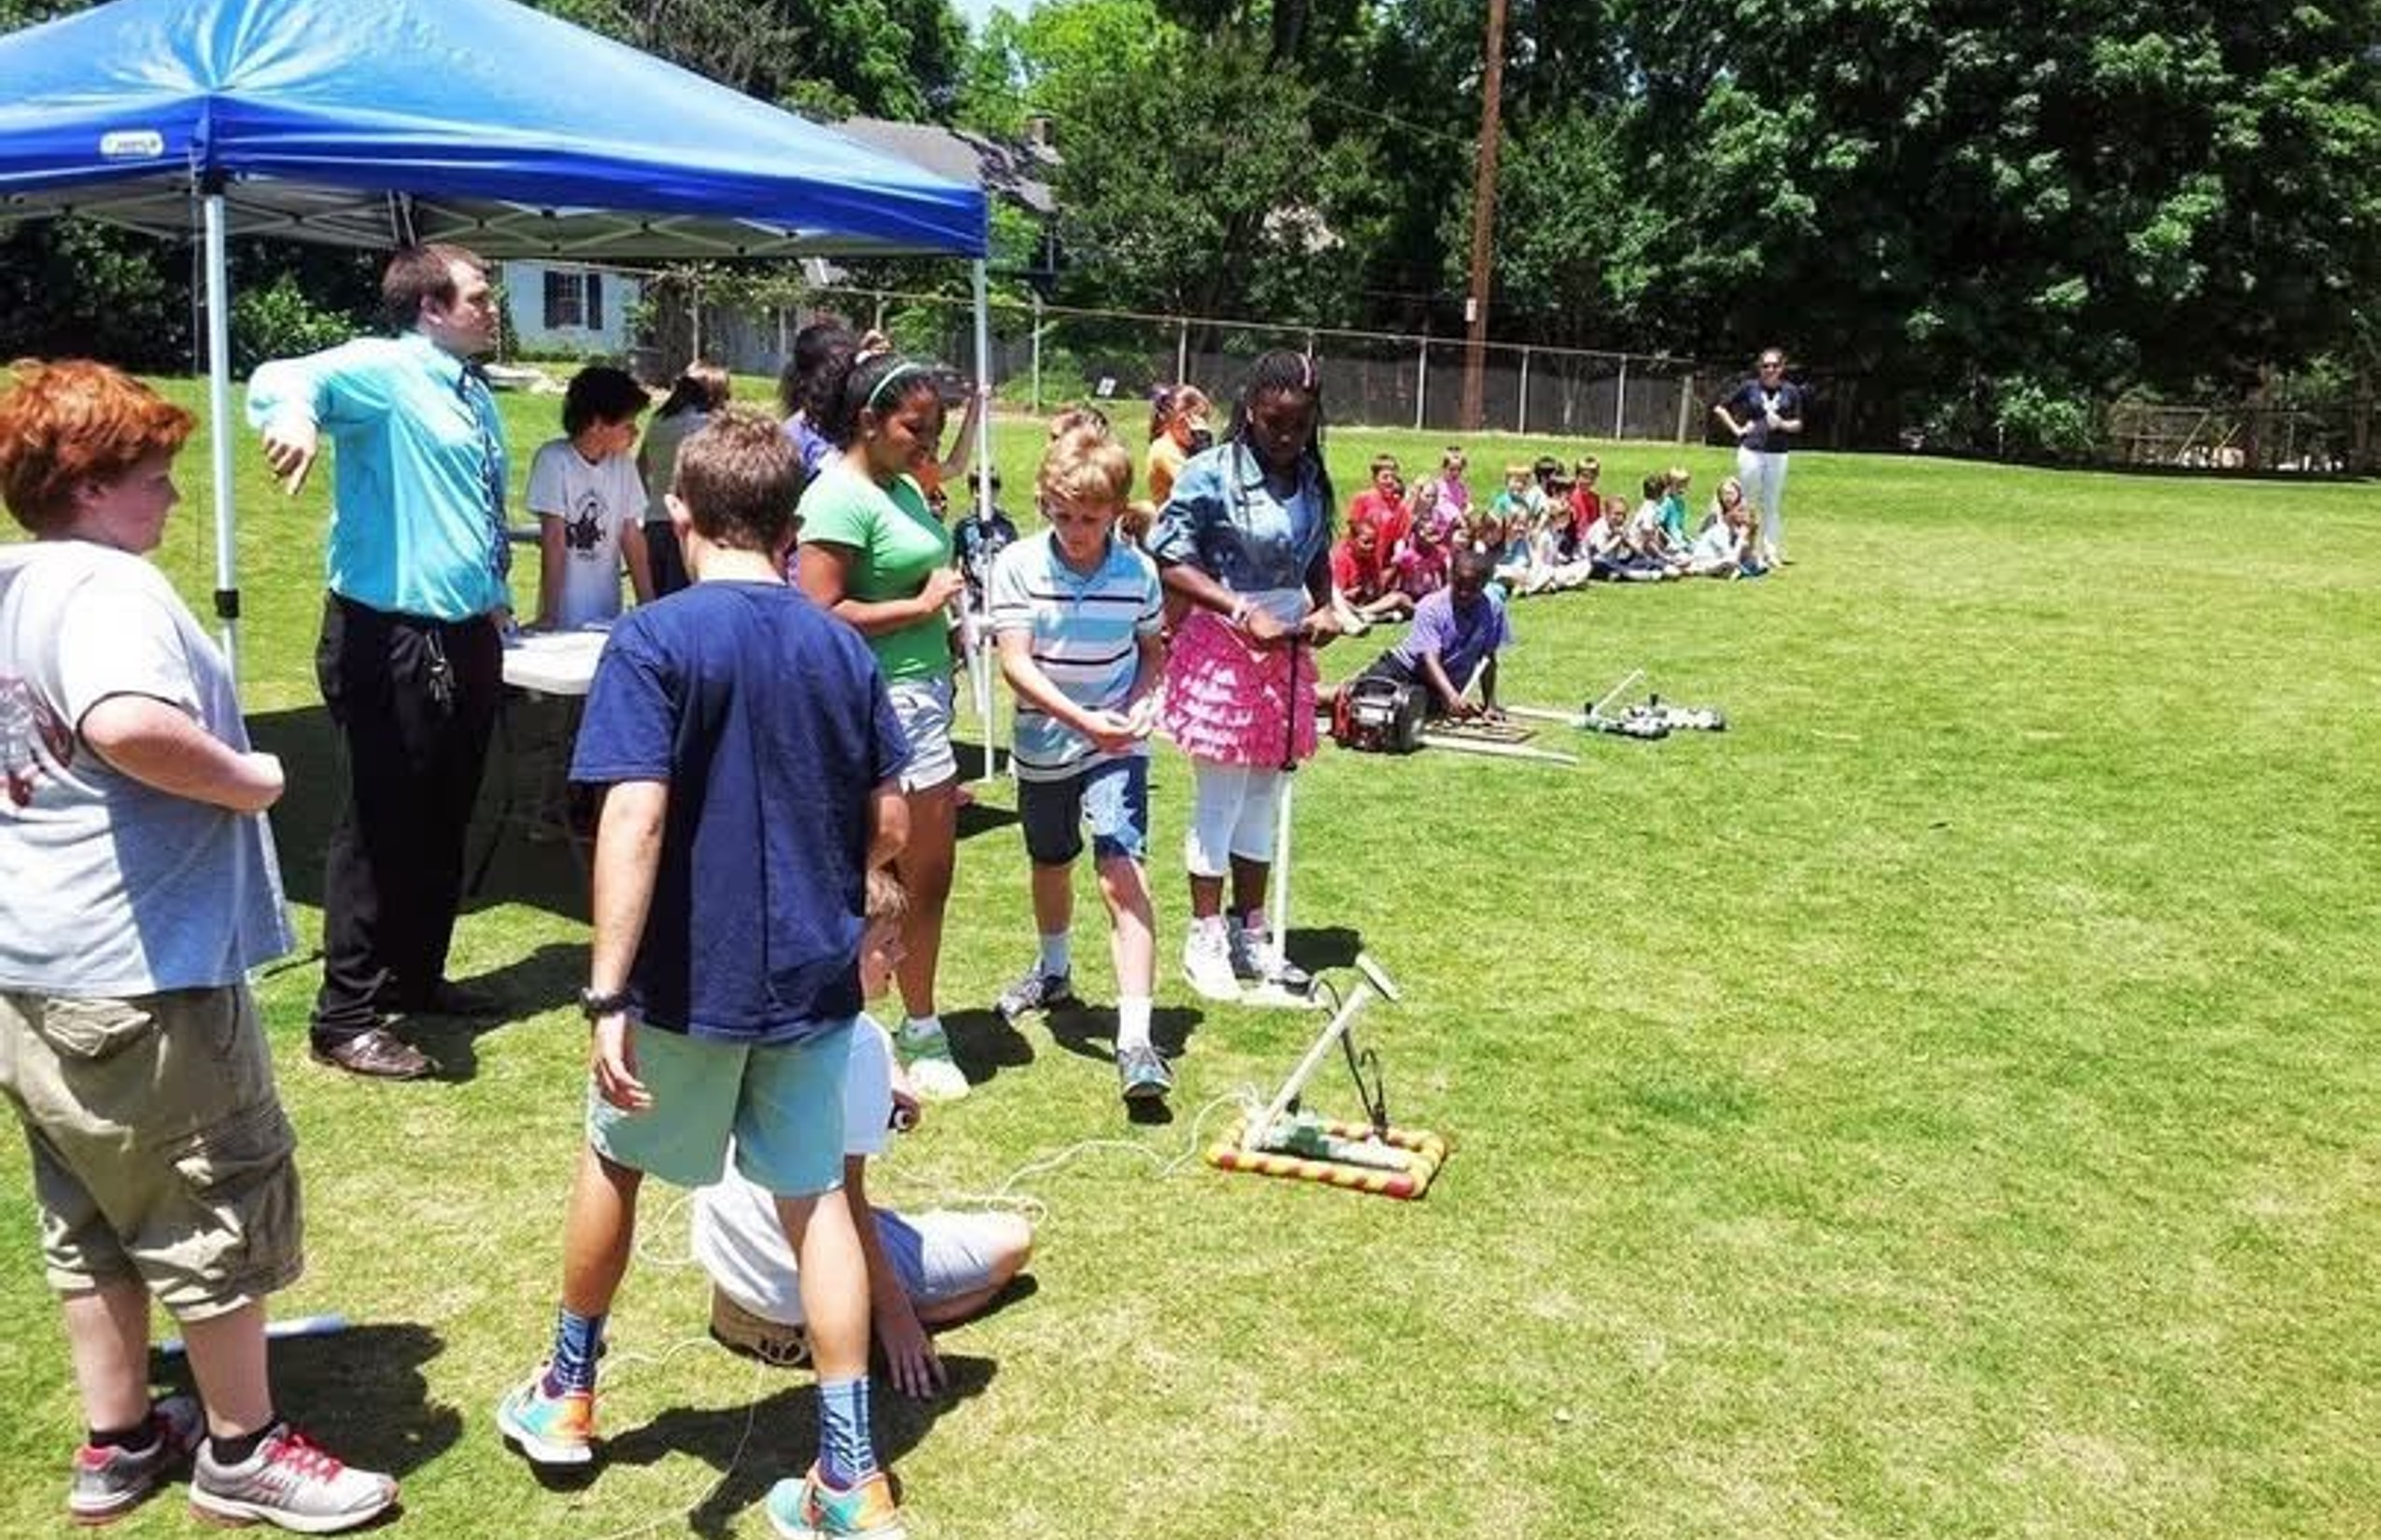
CULTIVATING CURIOSITY, CRITICAL THINKING, AND CREATIVE CONFIDENCE
Program Catalog
Hands-on STEM workshops, ready to drop into your curriculum at any grade.
makerlabkids.com
Serving Metro Atlanta

Slide 2

How to use this book
This guidebook contains a listing of the programs that we offer and how they can be adapted to meet grade level and academic needs. This is not a comprehensive list - we are more than happy to adapt to your specific school, classroom, and academic needs.
What you'll find on each program page
A real photo from the field - Not stock imagery. Every picture is from a workshop we've actually run.
Logistics - What students take home, what space we need, any safety notes.
Grade-level lessons - This maps the specific adaptation of the program to our understanding of the Georgia educational standards.
QR code & URL - Scan or click to view additional information online.
Pricing, service area, and booking are all on makerlabkids.com/pricing. Multi-session discounts available, free travel within 30 miles of Atlanta, reasonable charges beyond that.
Educator resources - We're actively adding printable data collection sheets, lesson plans, standards alignment, etc. under the "Instructor Resources" side panel on each program's page.
Don't see exactly what you need?
We work with teachers to align what we teach to their specific classroom - a program can be reshaped around a particular unit, standard, or group of students. We love building new programs from scratch. Reach out and tell us what you're thinking - brainstorming sessions are FREE!
Find every program online
The full, filterable catalog with every grade-level adaptation and standards alignment lives at makerlabkids.com/catalog. The web version is the canonical source - this printed catalog is a starting point.

Slide 3
Index of programs
Rockets & Flight
Science & Discovery
Compressed Air Rockets ☆
Listening with Tools
Powered Paper Planes
Non-Newtonian Fluids - Oobleck
Drone Pilot Training
Magnet Explorers
Parachute Engineering
Paper Plate Speaker
Electronics
Diffraction Grating Glasses
Weather Station
Intro to Soldering
Arduino Basics
Build a Radio
Robotics
Brush Bots
Battle Bots Camp
VEX Robotics Consulting
Fire & Forge
Mini Blacksmithing
Tesla Coil Workshop
Metal Casting
Digital Fabrication
3D Printing
Cybersecurity & Code
Lockpicking 101
Ethical Hacking Intro
Hacker Mindset
Cyber Sleuth

Slide 4


Compressed Air Rockets
Rockets & Flight • FLAGSHIP
Design, build, and launch your own high-flying rocket powered by compressed air!
Take-home: Students keep their rockets
Space needed: Outdoor area - field, playground, or parking lot
Online: /programs/compressed-air-rockets/
compressed-air
LEVEL
TOPIC
LESSON
Pre-K
Intro to STEM
Pump and Launch
Pump up the rocket and watch it fly! A few pumps goes a little way; a lot of pumps goes way farther. Take turns launching and chasing.
Kindergarten
Physical Attributes & Motion (pushes/pulls)
The Push Investigation [SKP2]
Test 3, 6, and 10 pumps. Walk heel-to-toe to each landing spot and count steps together. "More pumps = more push = farther!"
Kindergarten
Addition/Subtraction & Geometry
Rocket Bocce [K.OA]
Launch closest to the target cone. Compare "closer" and "farther." Count steps to each rocket to find the winner.
1st Grade
Measurement, Time, & Geometry
Distance Station [1.MD]
Measure flight distance with a tape measure. Record in feet and inches. Compare results on a class chart.
2nd Grade
Forces; Matter & Physical Changes
Fin Design Testing [S2P2]
Build rockets with different fins (big, small, none). Predict which flies farthest. Test and compare - does the shape change the flight?
2nd Grade
Measurement, Money, & Shapes
Measurement Stations [2.MD]
Students rotate through stations measuring distance (tape measure), time (stopwatch), and altitude (angle tracker). Record in inches and feet.

Slide 5
Compressed Air Rockets
Grade-level lessons (continued)
LEVEL
TOPIC
LESSON
4th Grade
Multi-digit Multiplication/Division
Launch Data Math [4.NBT]
Record pump count and flight distance for each student. Calculate average distance and compare across classes.
4th Grade
Geometry
Angle Optimization [4.MD] [4.G]
Set the launcher to different angles (15, 30, 45, 60, 75). Measure distance for each. How does the angle affect distance? What angle maximizes distance?
4th Grade
Light, Sound, & Motion
Forces of Flight [S4P3]
Investigate the three forces acting on a rocket: thrust (air pressure pushing up), gravity (pulling down), and drag (air resistance). Add mass to the nose cone and examine how balanced vs. unbalanced forces change the flight.
5th Grade
Decimals & Order of Operations
Launch Data Analysis [5.NBT]
Record altitude, distance, and time as decimals. Calculate averages across multiple launches.
5th Grade
Volume
Rocket Body Volume [5.MD]
Calculate the volume of the cylindrical rocket body and cone nose. How does volume relate to weight and flight performance?
6th Grade
Ratios
Pressure Ratios [6.RP]
Double the pressure: does distance double? Test ratios of pressure to distance. Calculate unit rates (feet per PSI).
6th Grade
Expressions/Stats
Stats of a Launch Day [6.SP]
Collect 30+ launches from the class using different launchers. Calculate mean, median, and range of distance. Build a box plot. Which launcher had the widest spread? The most consistent?
7th Grade
Numbers/Equations
Solve for the Missing Variable [7.EE]
Launch rockets as a group. Measure the distance it traveled and the time it was in the air. Solve d = v x t for velocity. Which rocket had the highest velocity? Which rocket had the highest average velocity?
8th Grade
Equations
Graphing Launch Data [8.EE] [8.F]
Plot angle vs. distance on a coordinate plane. Identify the function. Is it linear?
8th Grade
Functions/Geometry
Linear Functions of Pressure [8.F]
Graph distance vs. PSI. Is it a linear function? Find the rate of change and y-intercept. Predict distance at a new PSI, then test your prediction.
8th Grade
Force/Energy
Newton's Laws in Action [S8P3]
Launch the same rocket at different pressures: 20, 40, 60, 80 PSI. Measure distance each time. With mass held constant, how does doubling the launch force change the distance? Plot pressure vs. range and compare to F=ma.
Algebra
Linear functions, equations/inequalities, and rate of change
Rate of Change [A.CED] [F.LE]
Plot pressure vs. distance. Calculate slope as rate of change. Where does the relationship break down?

Slide 6
Compressed Air Rockets
Grade-level lessons (continued)
LEVEL
TOPIC
LESSON
Algebra
Quadratic & Exponential functions, modeling, and data analysis
Quadratic Trajectories [F.IF] [F.BF]
Model flight path as a parabola. Use height-vs-time data to fit a quadratic. Predict landing distance from the equation.
Geometry
Right triangle trigonometry, circles, volume, and surface area
Altitude Tracking with Trig [G.SRT]
Measure the angle from ground to the rocket at its apex from known distance away from the rocket. Use trigonometry to calculate real altitudes from their launches.
Advanced Algebra
Radical functions, logarithmic modeling, and statistical reasoning
Radical Functions for Time of Flight [F.BF]
Time aloft = sqrt(2h/g). Graph this radical function. Solve for h given t. Verify with real altitude data.
Pre-Calculus
Trigonometry, polar coordinates, vectors, and parametric equations
Vector Decomposition [Pre-Calc]
Decompose launch velocity into horizontal and vertical components. Use vectors to predict landing point with wind correction.
Calculus AB / BC
Limits, continuity, differentiation; BC adds parametric/polar/vectors
Differentiation of Motion [AP Calc]
Take video of a launch. Frame-by-frame position gives position s(t). Differentiate to get velocity v(t), then acceleration a(t). Verify gravitational acceleration near apex.
Calculus AB / BC
Limits, continuity, differentiation; BC adds parametric/polar/vectors
Parametric Flight (BC) [AP Calc BC]
Flight as parametric equations x(t), y(t). Find dy/dx along the trajectory. Where is dy/dx = 0? Derive arc length integral.
AP Statistics
Data exploration, sampling, experiments, and probability
Statistical Launch Analysis [S.ID]
Collect class launch data. Create scatter plots of angle vs. distance. Find the line of best fit. Identify outliers and explain them.
AP Statistics
Random variables, binomial/normal distributions, and statistical inference
Confidence Intervals for Distance [S.IC]
Launch 30 identical rockets. Compute mean distance and build a 95% confidence interval. Does the interval change with sample size? Test your hypothesis.
Physics
Kinematics (motion), Newton's Laws, gravity, and energy
Projectile Motion Lab [SP1] [SP2]
Full kinematics lab: measure launch velocity, decompose into vector components, predict range and max height, verify with real data.
AP Physics 1
Kinematics, Dynamics, Circular motion, and Gravitation
Complementary Angles Challenge [AP 1 Units 1-3]
Find two angles (15+ degrees apart) that land at the same distance. Prove complementary angles yield equal range using kinematic equations.
AP Physics C
(Calculus-based) Mechanics, Kinematics, and Force
Calculus-Based Flight Analysis [AP C Mech]
Derive the trajectory equation from F=ma. Account for drag as a velocity-dependent force. Compare ideal vs. real flight data.

Slide 7
Compressed Air Rockets
Grade-level lessons (continued)
LEVEL
TOPIC
LESSON
AP Physics C
(Calculus-based) Mechanics, Kinematics, and Force
Volumetric Flow Rate [AP C Mech]
Wire an Arduino relay to the launch valve and time how long it takes to bleed the pressure chamber dry. Model dP/dt as pressure-dependent flow, integrate to recover P(t), and solve for the volumetric flow rate Q(t). Does the calculus match the Arduino's timer?

Slide 8
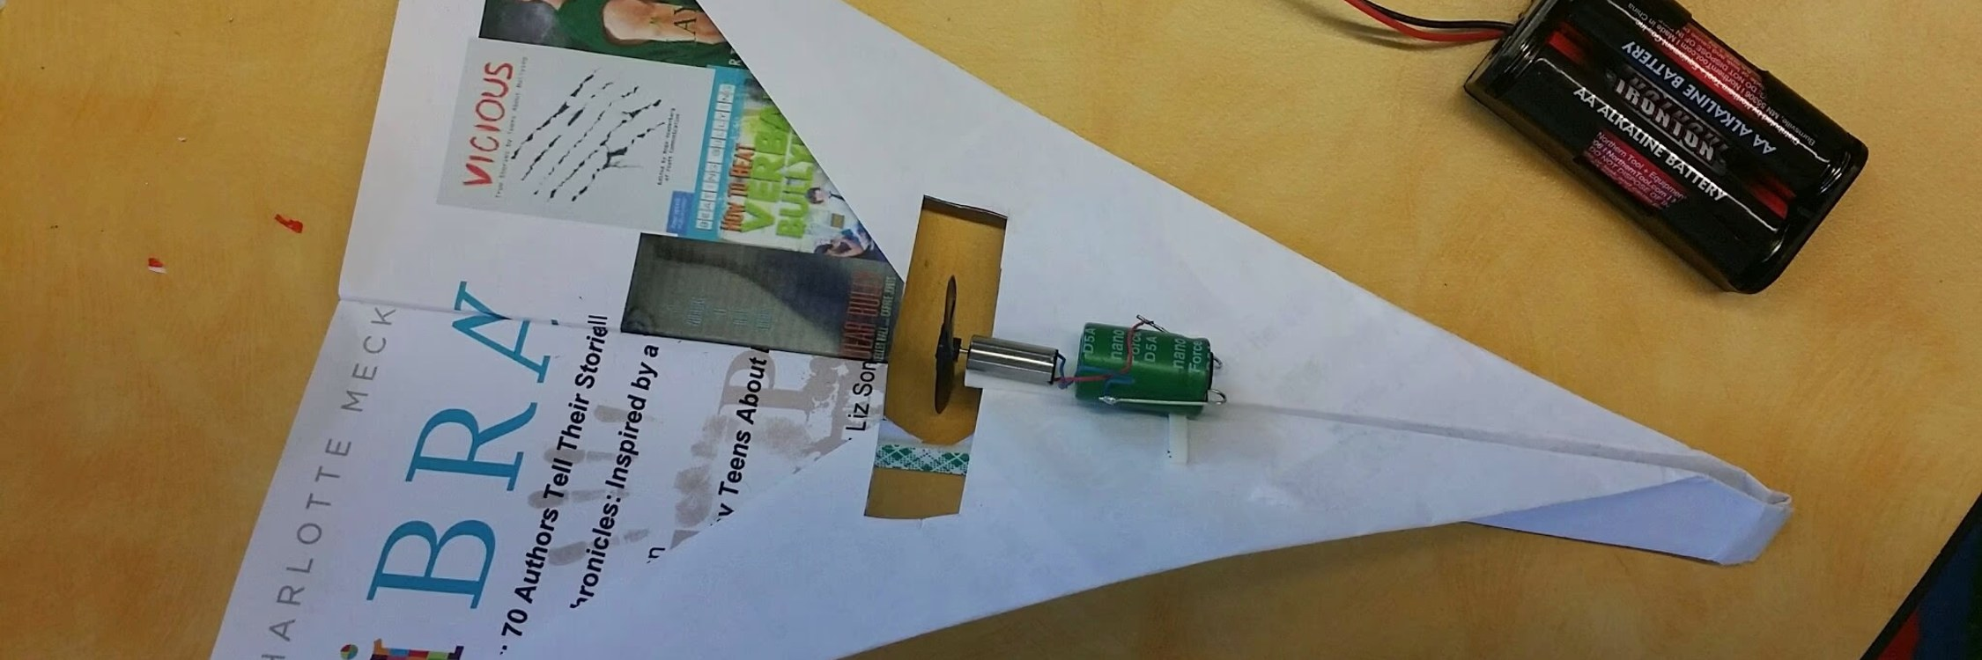

Powered Paper Planes
Rockets & Flight
Transform ordinary paper planes into motorized flying machines!
Take-home: Their paper planes plus the capacitor, charging resistor, and motor that power them
Space needed: Gym, cafeteria, or large classroom
Online: /programs/powered-paper-planes/
powered-paper-
LEVEL
TOPIC
LESSON
4th Grade
Geometry
Angle of Attack [4.G]
Bend the ailerons and rudder to different angles. Measure each angle with a protractor. Which angles make the plane climb, dive, turn, or fly level?
8th Grade
Force/Energy
Four Forces with Thrust [S8P3]
Identify lift, drag, thrust, and weight on a powered plane. Bend the ailerons and rudder to redirect the forces in flight - how does changing the control surfaces shift balanced to unbalanced forces and change the flight path?
Physics
Kinematics (motion), Newton's Laws, gravity, and energy
Control Surfaces and Flight [SP2]
Draw the free-body diagram for a paper plane in steady flight. Now bend the ailerons and rudder to measured angles, launch, and measure how far the plane lands off a straight-line target. Does the deflection distance grow linearly with the angle, or faster, or slower? Try each control surface alone and together - which one bends the flight path more?

Slide 9
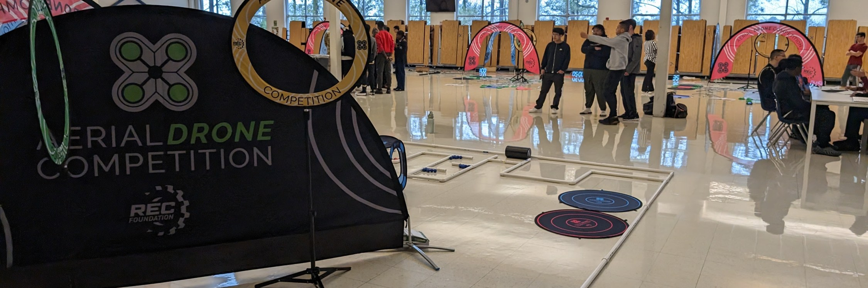

Drone Pilot Training
Rockets & Flight
Learn to fly quadcopters on our obstacle and race course, plus prepare for FAA TRUST certification.
Space needed: Gym or large indoor space
Online: /programs/drone-pilot-training/
drone-pilot-tr
LEVEL
TOPIC
LESSON
4th Grade
Geometry
Navigation Angles [4.G]
Plan your flight path through an obstacle course using basic geometry. Turn 90 degrees left, 45 degrees right. Estimate angles before you fly them.
4th Grade
Light, Sound, & Motion
Four Forces of Flight [S4P3]
Identify thrust, drag, lift, and gravity on a quadcopter. Tilt forward: what's unbalanced? Hover: what's balanced? Fly and observe.
8th Grade
Functions/Geometry
3D Pythagorean Distance [8.G]
Start with your drone at a known position. Calculate straight-line distance using sqrt(x^2 + y^2 + z^2) to target destination. Turn to the computed heading, then fly the computed distance to verify the direct path.
8th Grade
Force/Energy
Thrust vs. Weight [S8P3]
Calculate the thrust needed to hover (thrust = weight). Why do the motors spin faster when tilted even though the drone doesn't go up? Add payload and recalculate.
Geometry
Right triangle trigonometry, circles, volume, and surface area
3D Navigation [G.GMD]
Navigate an obstacle course in 3D space. Calculate distances between waypoints using 3D distance formula. Calculate the volume of the air space.

Slide 10
Drone Pilot Training
Grade-level lessons (continued)
LEVEL
TOPIC
LESSON
Pre-Calculus
Trigonometry, polar coordinates, vectors, and parametric equations
Vector Navigation [Pre-Calc]
Plan a flight path using vectors. Account for wind as a vector addition problem. Navigate from waypoint to waypoint with heading and magnitude.
Physics
Kinematics (motion), Newton's Laws, gravity, and energy
Free Body Diagrams [SP2]
Draw free body diagrams for hover, climb, and forward flight. Resolve forces into components. Why must the drone tilt to move forward?
AP Physics 1
Energy, Momentum, Torque, and Rotational motion
Rotational Dynamics [AP 1 Unit 7]
How does the drone spin in place? Analyze propeller rotation, angular velocity, and moment of inertia to figure it out.

Slide 11
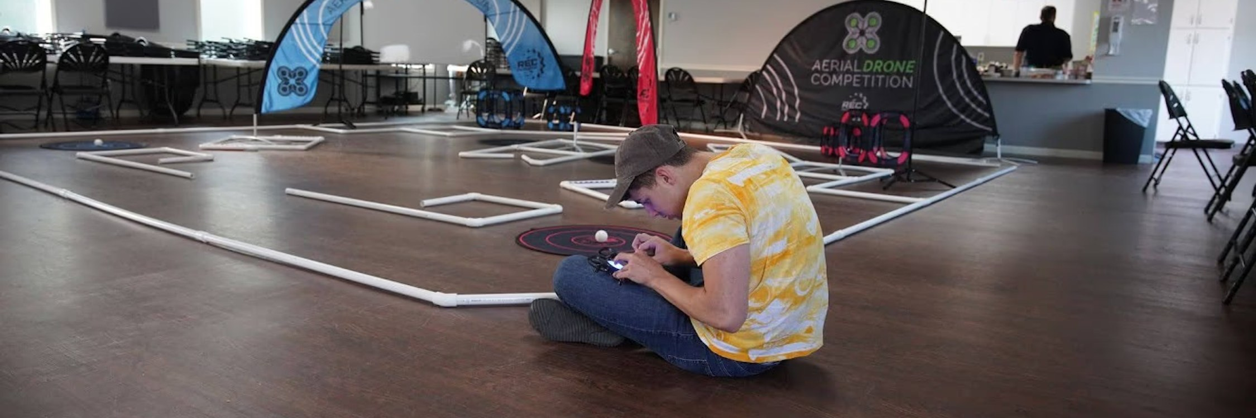

Parachute Engineering
Rockets & Flight
Design, build, and test parachutes with real engineering methods! Drone deployment for rapid iteration.
Take-home: Multiple parachute designs + payload container
Space needed: High ceiling gym or outdoor field (outdoor preferred)
Online: /programs/parachute-engineering/
parachute-engi
LEVEL
TOPIC
LESSON
2nd Grade
Forces; Matter & Physical Changes
Gravity vs. Air [S2P2]
Drop different shapes (flat, crumpled, parachute). Which force wins - gravity pulling down or air pushing up? Predict then test.
2nd Grade
Measurement, Money, & Shapes
Measure the Canopy [2.MD]
Compare parachutes in circles and squares, different sizes. Measure each canopy across with a ruler. A drone lifts each to the same release altitude for a fair test. Does a bigger parachute = slower drop?
3rd Grade
Fractions, Area, & Perimeter
Surface Area Lab [3.MD]
Cut rectangular parachutes in three sizes: small, medium, large. Measure length and width then calculate area. A drone drops them from the same height. Which area wins the slow-fall contest?
4th Grade
Light, Sound, & Motion
Balanced Forces [S4P3]
Build parachutes, then use a drone to release them from a tall, repeatable altitude. Observe that once the upward drag force grows to match the downward pull of gravity, the net force is zero and speed stops changing - that steady speed is terminal velocity.
5th Grade
Decimals & Order of Operations
Decimal Timing [5.NBT]
Time drone-deployed parachutes to hundredths of a second. Calculate averages across 3 drops. Compare designs using decimal subtraction.

Slide 12
Parachute Engineering
Grade-level lessons (continued)
LEVEL
TOPIC
LESSON
6th Grade
Ratios
Area-to-Weight Ratios [6.RP]
Design parachutes with different canopy sizes and payload weights. Drone-drop each from a fixed altitude. Calculate the area-to-weight ratio and unit rate (seconds per square inch). Does doubling the ratio double the fall time?
8th Grade
Force/Energy
Terminal Velocity [S8P3]
Build parachutes varying shroud length, gore shape, and vent size. Drone-drop each from identical altitudes. Video-track velocity vs. time and mark the point where net force goes to zero and speed levels off.
Advanced Algebra
Complex numbers, polynomial functions, and rational expressions
Rational Drag Models [A.APR]
Build parachutes with varying canopy area, shroud length, and gore shape. Model terminal velocity = sqrt(weight / drag_coefficient) as a rational expression. Drone-drop each design from the same altitude to verify.
Calculus AB / BC
Integration, differential equations
Integration of Drag [AP Calc]
Build parachutes with varying shroud length and gore shape. Drone-drop from fixed altitude. Solve dv/dt = g - (k/m)v^2, integrate velocity to get position, and compare to the measured drop.
Physics
Kinematics (motion), Newton's Laws, gravity, and energy
Free Fall Lab [SP1] [SP2]
Build payloads with and without parachutes. Drone-drop from a measured altitude; video-track the fall. Fit position vs. time and extract acceleration. Compare free-fall g to 9.8 m/s2 and quantify the drag offset.
AP Physics 1
Kinematics, Dynamics, Circular motion, and Gravitation
Air Resistance Modeling [AP 1 Units 1-2]
Build parachutes varying shroud length, gore shape, and canopy area. Drone-release from a repeatable altitude for clean trials. Video-track position, fit velocity-dependent drag, and extract drag coefficients per design.

Slide 13
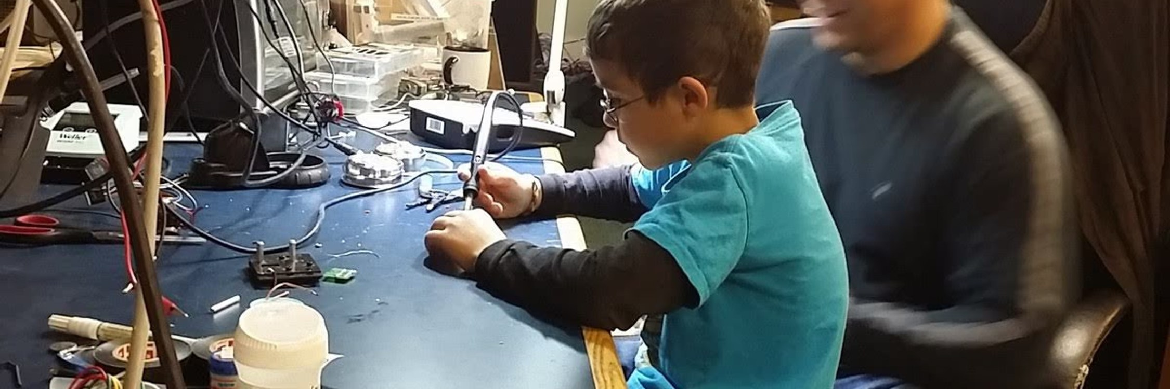

Intro to Soldering
Electronics
Learn the essential skills for soldering and build your own LED project!
Take-home: Students keep their LED projects
Space needed: Tables, outlets, ventilation
Online: /programs/intro-to-soldering/
intro-to-solde
LEVEL
TOPIC
LESSON
5th Grade
Electricity, Magnetism, & Chemistry
Build a Circuit [S5P2]
Make your own paper and foil circuit board. Then solder real electronic components on to make a working circuit. Your LED lights up when the circuit is complete!
8th Grade
Force/Energy
LED Tree [S8P5]
Solder a multi-LED tree and measure voltage across each branch with a multimeter. What happens to the other LEDs when one branch opens? Why?
Physics
Waves, sound, light/optics, electricity, and magnetism
Ohm's Law Lab [SP5.d]
Solder a circuit with resistors in series and parallel. Measure V, I, and R with a multimeter. Verify V=IR and calculate power dissipation.

Slide 14
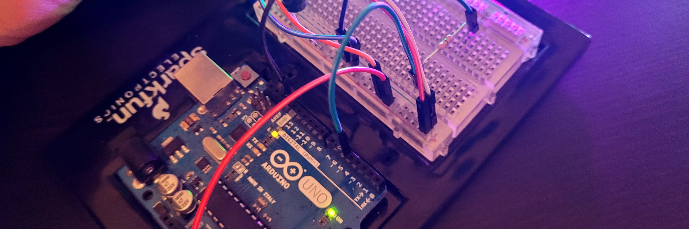

Arduino Basics
Electronics
Program microcontrollers to control lights, motors, and sensors!
Take-home: Students keep their Arduino boards
Space needed: Tables with computers and internet access
Notes: Computers must have Arduino Cloud Agent installed
Online: /programs/arduino-basics/
arduino-basics
LEVEL
TOPIC
LESSON
5th Grade
Electricity, Magnetism, & Chemistry
Programmable Circuits [S5P2]
Wire LEDs, buttons, and sensors to a microcontroller. Write code to control the circuit. Make lights blink in patterns you design.
6th Grade
Expressions/Stats
Sensor Thresholds [6.EE]
Write an inequality for your alarm: if sensor > threshold, beep. Rearrange the expression to find the trigger temperature. Test it with real sensor data.
8th Grade
Equations
Linear Functions from Sensor Data [8.F]
Graph Arduino temperature sensor voltage vs. actual temperature. Find the linear function y = mx + b from the data. Use your equation to predict the temperature at a new voltage reading, then verify.
8th Grade
Force/Energy
Sensor-Driven Circuits [S8P5]
Wire light sensors, temperature sensors, and motors. Program the Arduino to respond to input. Build a circuit that reacts to the environment.
Algebra
Linear functions, equations/inequalities, and rate of change
Sensor Data Modeling [A.CED]
Read temperature sensor data over time. Write a linear equation that models the cooling curve. Predict the temperature at time t.

Slide 15
Arduino Basics
Grade-level lessons (continued)
LEVEL
TOPIC
LESSON
Advanced Algebra
Radical functions, logarithmic modeling, and statistical reasoning
Exponential RC Charging [F.LE] [F.BF]
Capacitor voltage follows V(t) = V0(1 - e^(-t/RC)). Measure the charging curve, fit the model, then invert it with logarithms to solve for t at any target voltage.
Pre-Calculus
Polynomial, rational, exponential, and logarithmic functions
Logarithmic Sensor Response [F.BF]
Photoresistors respond logarithmically to light. Calibrate a sensor and derive the log conversion formula. Invert it to get light intensity from voltage.
Calculus AB / BC
Integration, differential equations
Solving RC Differential Equations [AP Calc]
The RC circuit obeys dV/dt = -V/RC. Solve the Ordinary Differential Equation (ODE) analytically, then compare to Arduino-measured data. Measure the time constant three ways.
AP Statistics
Data exploration, sampling, experiments, and probability
Sensor Data Exploration [S.ID]
Collect temperature, light, or motion data from Arduino sensors. Create histograms and scatter plots. Describe the distribution and identify patterns.
Physics
Waves, sound, light/optics, electricity, and magnetism
Speed of Sound [SP4]
How fast does sound travel? Wire up an ultrasonic rangefinder, read the raw echo pulse to get the round-trip time in microseconds, and solve for the speed using a known distance. Compare the raw timing, the sensor-calculated value, and the textbook value - where does the disagreement come from?
AP Physics C
Electricity and Circuitry
RC Circuit Analysis [AP C E&M]
Build RC circuits and measure exponential charge/discharge curves. Fit the equation V(t) = V0*e^(-t/RC). Determine the time constant.

Slide 16
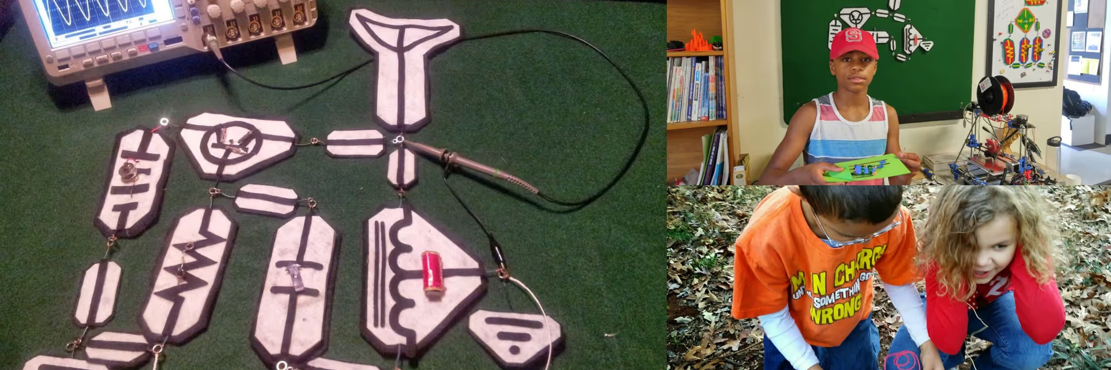

Build a Radio
Electronics
Build a working AM transmitter from basic components using our Feltronics system!
Take-home: Students keep their paper radios
Space needed: Tables with outlets
Online: /programs/build-a-radio/
build-a-radio
LEVEL
TOPIC
LESSON
5th Grade
Electricity, Magnetism, & Chemistry
Circuit from Scratch [S5P2]
Build a working AM transmitter from 5 simple parts soldered onto paper and foil. Learn what each of the components does on its own and then how it contributes to make a real radio work.
8th Grade
Force/Energy
EM Waves in Action [S8P4] [S8P5]
Solder an AM transmitter and make a germanium diode receiver. Change the battery voltage and see how that affects the distance the radio works?
Physics
Waves, sound, light/optics, electricity, and magnetism
LC Resonance [SP5.d]
Solder a working AM transmitter. Trace the signal through the schematic stage-by-stage. Calculate the resonant frequency from component values, then slide the ferrite and find your signal with a commercial AM radio to see where you actually land.

Slide 17
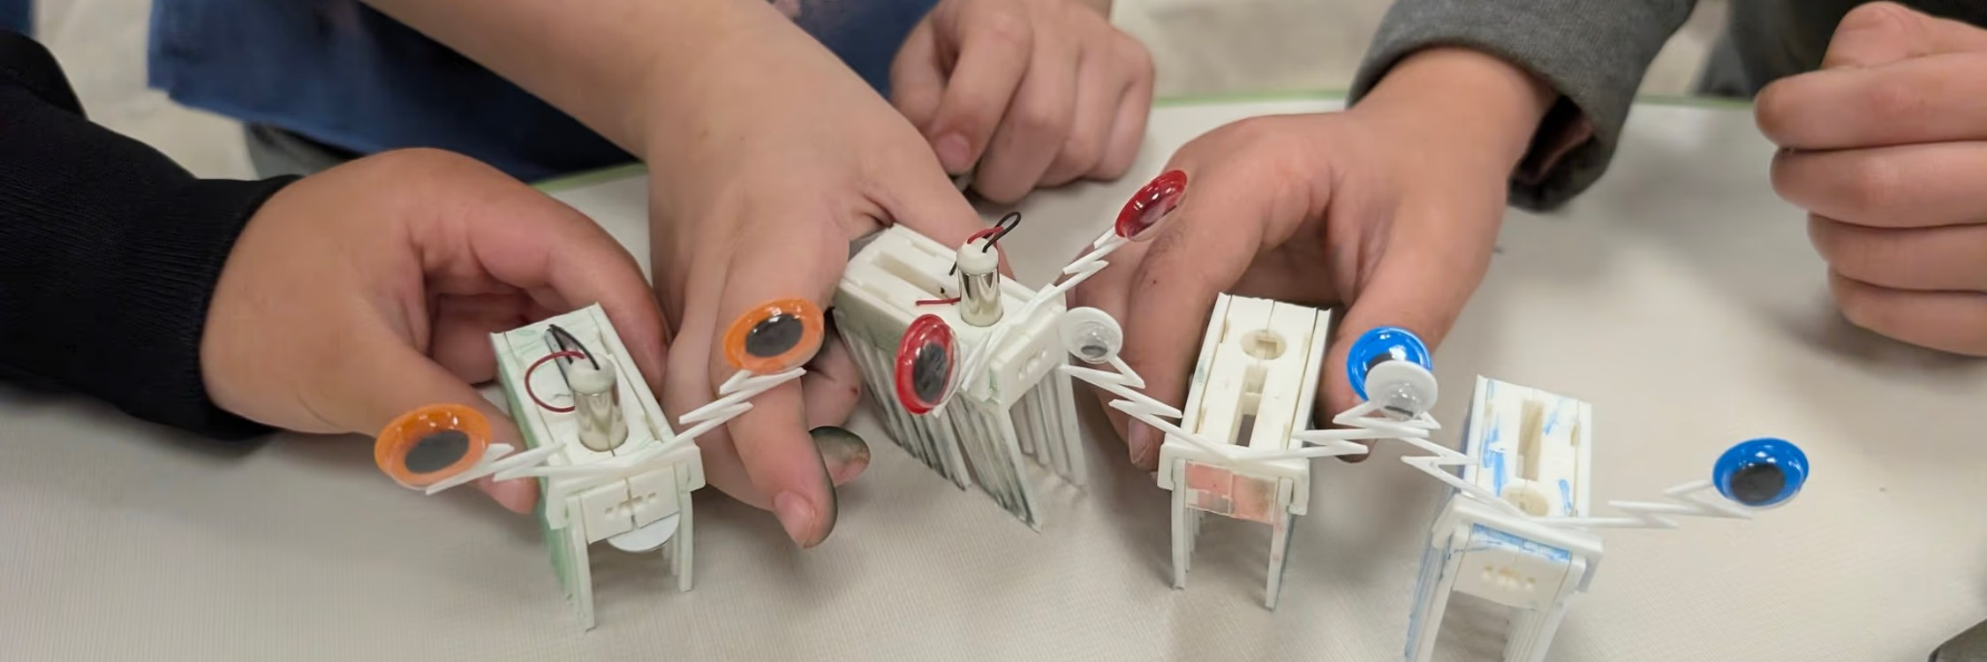

Brush Bots
Robotics
Build vibrating robots from toothbrushes - perfect for beginners!
Take-home: Students keep their brush bots
Space needed: Tables plus smooth floor for racing
Online: /programs/brush-bots/
brush-bots
LEVEL
TOPIC
LESSON
Kindergarten
Counting & Sorting
Count the Legs [K.CC]
Count the legs on your bot. 3 legs? 4? 6? Compare with a partner - who has more? Which leg count walks straightest?
Kindergarten
Physical Attributes & Motion (pushes/pulls)
Vibration Motion [SKP2]
Turn on the motor and watch it shake! Place it on a table and observe how vibration makes it move. Is it a push or a pull?
Kindergarten
Addition/Subtraction & Geometry
Race Day [K.OA]
Race bug bots across the table! Who went farthest? Count squares on the grid to compare. Practice "more than" and "less than."
1st Grade
Light & Sound; Magnets
Surface Sound Test [S1P1]
Run bug bots on a table, a book, and carpet. Listen to the different sounds. Which surface makes the loudest buzz? The quietest?
4th Grade
Light, Sound, & Motion
Vibration and Motion [S4P2] [S4P3]
The motor vibrates (sound!) and the unbalanced weight creates motion (force!). Change the weight position and observe how the path changes.
5th Grade
Electricity, Magnetism, & Chemistry
Simple Circuit Creatures [S5P2]
Connect battery to motor with wires - that's a circuit! Draw the circuit diagram - a schematic. Trace the path electricity follows. What happens if you break the circuit?

Slide 18

Battle Bots Camp
Robotics
Photo coming soon
Build a combat robot and battle it out in our arena - week-long intensive camp!
Space needed: Workshop area + arena space
Notes: Bot kit cost additional based on level selected
Online: /programs/battle-bots/
battle-bots
LEVEL
TOPIC
LESSON
8th Grade
Force/Energy
Force, Mass, and Combat [S8P3] [S8P5]
Calculate the force of impact using F=ma. Heavier bot or faster bot - which has more impact? Wire motors and learn circuit design for the drive system.
Calculus AB / BC
Limits, continuity, differentiation; BC adds parametric/polar/vectors
Instantaneous Rate of Change [AP Calc]
Mount a high-g accelerometer on each bot and log a(t) through a collision at 1 kHz. Integrate once to recover velocity, twice to recover position. Differentiate a(t) to get jerk (d^3x/dt^3) - the rate g-forces change during impact. Snap (d^4x/dt^4) is the stretch goal and noise-limited - a real lesson in signal quality.
Physics
Kinematics (motion), Newton's Laws, gravity, and energy
Newton's Third Law Arena [SP2]
Two bots collide. Onboard accelerometers capture peak g on each bot; multiply by mass to get impact force. Action-reaction predicts equal and opposite forces - does the data bear that out? The lighter bot always accelerates more - prove why using F = ma.
Physics
Waves, sound, light/optics, electricity, and magnetism
Motor Physics [SP5.e]
Measure motor current draw under load vs. no load. Calculate power consumption. How does gear ratio affect torque and speed?
AP Physics 1
Energy, Momentum, Torque, and Rotational motion
Impulse-Momentum Lab [AP 1 Units 4-5]
Onboard accelerometers log a(t) through the collision at 1 kHz. Multiply by bot mass and integrate to get impulse directly. Compare to change in momentum (p = mv before and after) - is momentum conserved? Quantify the impulse-momentum theorem with real data.

Slide 19
Battle Bots Camp
Grade-level lessons (continued)
LEVEL
TOPIC
LESSON
AP Physics C
(Calculus-based) Mechanics, Kinematics, and Force
Impulse with Calculus [AP C Mech]
Log a(t) from an onboard accelerometer through the collision. Compute F(t) = m*a(t), then integrate numerically to find impulse J = integral of F dt. Compare to change in momentum. Real data, real calculus, real-world noise.

Slide 20

VEX Robotics Consulting
Robotics
Photo coming soon
I coach the coaches! Help for new teams getting started or existing teams looking to level up.
Notes: Consulting services for VEX, FIRST, and competitive robotics teams
Online: /programs/vex-robotics-consulting/
vex-robotics-c
Grade-level lessons: VEX Robotics Consulting
Not currently in the grade-aligned catalog.

Slide 21
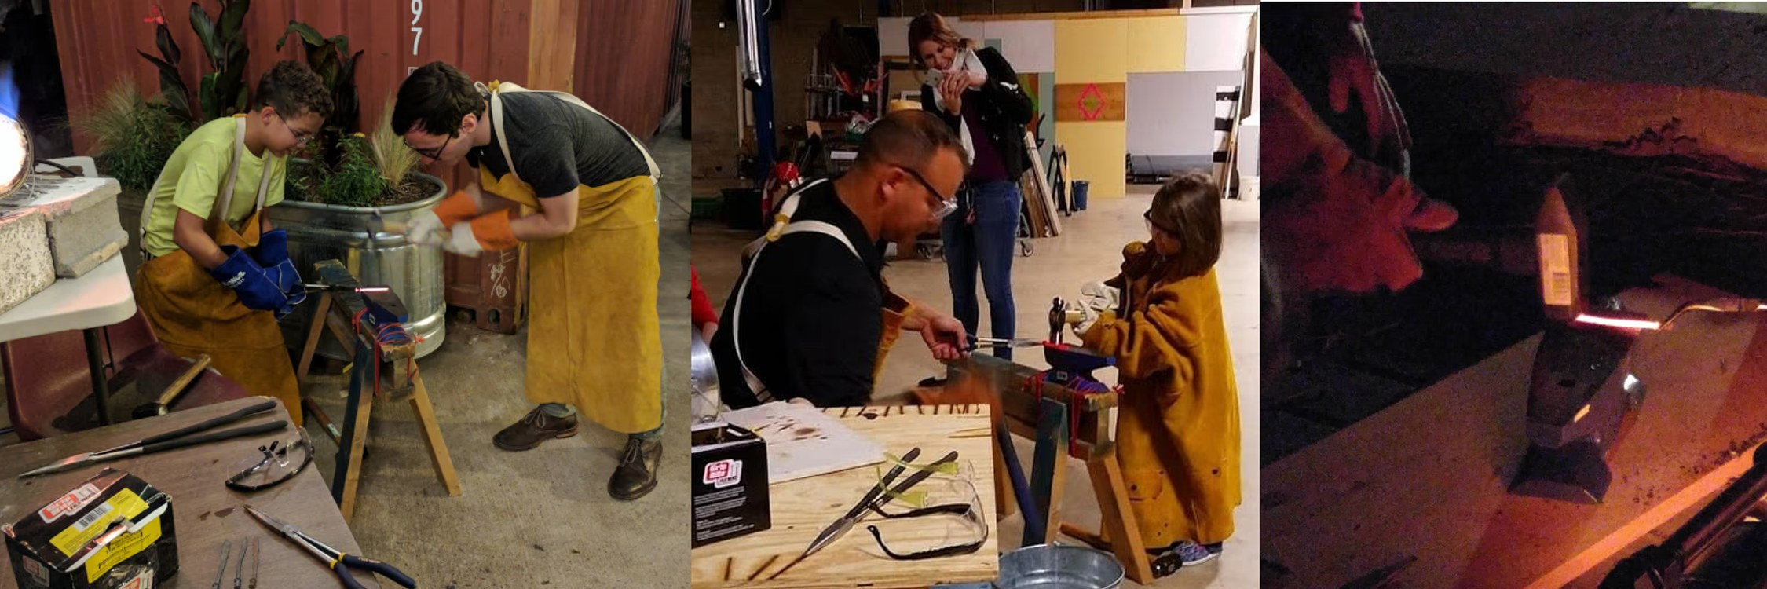

Mini Blacksmithing
Fire & Forge
Real blacksmithing - heat metal in a forge and hammer it into your own tiny sword!
Take-home: Students keep their tiny swords
Space needed: Indoor or outdoor area with ventilation
Online: /programs/mini-blacksmithing/
mini-blacksmit
LEVEL
TOPIC
LESSON
2nd Grade
Forces; Matter & Physical Changes
Hot Metal Changes [S2P1]
Watch metal change color as it heats. Hammer it while hot and it bends! Let it cool and it's hard again. Is this change reversible?
3rd Grade
Heat Energy
Heat Transfer in Action [S3P1]
Watch heat move from forge to metal (conduction). See the metal glow (radiation). Feel warmth from across the room (convection). All three types in one experience!
5th Grade
Electricity, Magnetism, & Chemistry
Change Detective [S5P1]
Heating metal is a physical change (reversible). But the scale that forms? That's oxidation - a chemical change! Identify both at the forge.
8th Grade
Matter/Chemistry
Phase Diagrams [S8P1]
Observe metal transition through phases. Map temperature to physical state. Identify crystalline structure changes when metal is quenched vs. annealed.
Advanced Algebra
Radical functions, logarithmic modeling, and statistical reasoning
Cooling Curves [F.LE]
Metal cooling follows Newton's law: T(t) = T_env + (T_hot - T_env)e^(-kt). Fit an exponential model to real temperature-vs-time data from the forge.

Slide 22
Mini Blacksmithing
Grade-level lessons (continued)
LEVEL
TOPIC
LESSON
Chemistry
Chemical reactions
Oxidation Reactions [SC5] [SC6]
Watch iron oxidize at high temperature (scale formation). Measure temperature changes as an exothermic/endothermic process. Balance the oxidation equation.

Slide 23
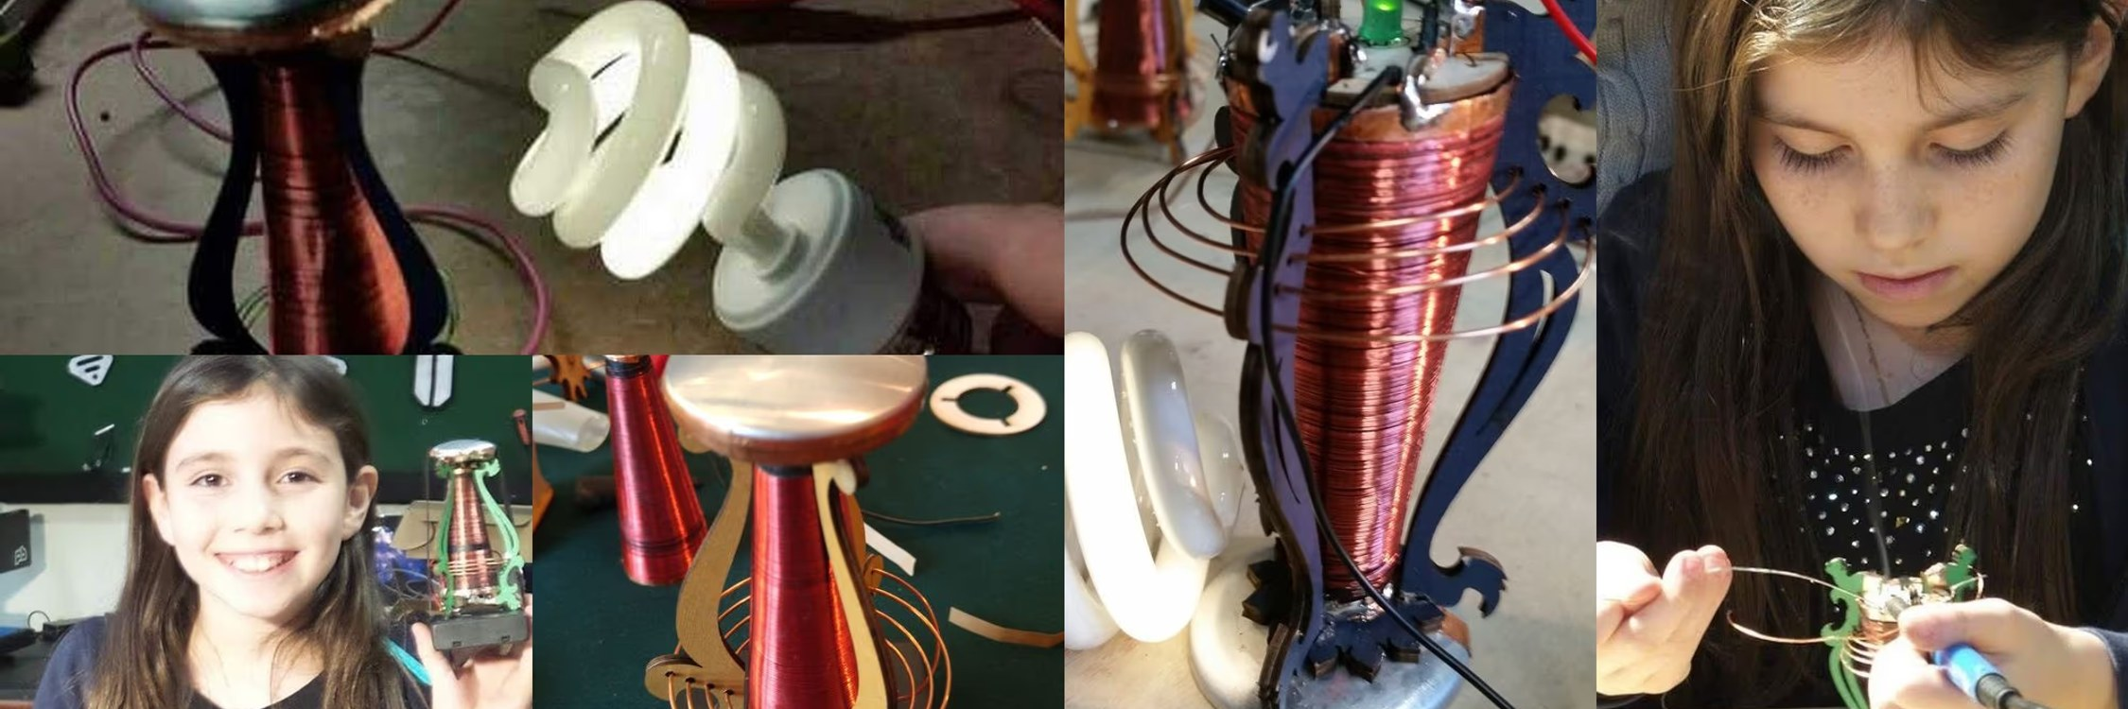

Tesla Coil Workshop
Fire & Forge
Build mini Tesla coils and explore high voltage safely!
Take-home: Students keep their mini Tesla coils
Space needed: Tables, outlets, and room for demonstrations
Online: /programs/tesla-coil-workshop/
tesla-coil-wor
LEVEL
TOPIC
LESSON
5th Grade
Electricity, Magnetism, & Chemistry
Electricity Meets Magnetism [S5P2] [S5P3]
Build a mini Tesla coil and watch electricity arc through the air! See how changing electric current creates a magnetic field.
8th Grade
Force/Energy
Electromagnetic Induction [S8P5]
Build a Tesla coil and observe wireless energy transfer. How does a changing magnetic field create voltage? Explore Faraday's discovery hands-on.
Physics
Waves, sound, light/optics, electricity, and magnetism
Turn Ratio and Step-Up Math [SP5.e]
Count the turns on the primary and secondary coils. Compute the turn ratio. Apply transformer math to predict the secondary voltage from a small battery input. Then estimate the real output by the spark length - air breaks down at roughly 1 kV per millimeter. Do the numbers agree?

Slide 24
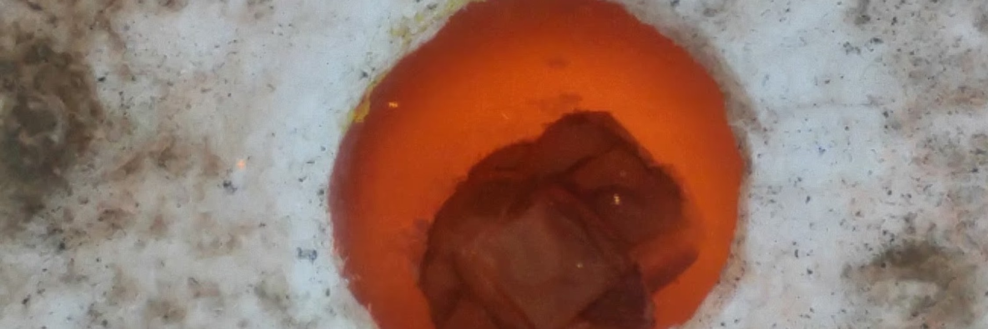

Metal Casting
Fire & Forge
Cast aluminum using the lost foam technique!
Take-home: Students keep their aluminum castings
Space needed: Outdoor area or well-ventilated workshop
Online: /programs/metal-casting/
metal-casting
LEVEL
TOPIC
LESSON
Geometry
Right triangle trigonometry, circles, volume, and surface area
Volume of Revolution [G.GMD]
Calculate the volume of a cylindrical mold. Compare to the irregular casting using water displacement. Which is more accurate - formula or measurement?
Calculus AB / BC
Integration, differential equations
Heat Integration [AP Calc]
Newton's Law of Cooling is a separable differential equation. Solve it, then integrate to find total heat released as aluminum solidifies.
Chemistry
Chemical reactions
Enthalpy of Fusion [SC4] [SC6]
Calculate the energy required to melt aluminum (heat of fusion). Observe the phase diagram in real time. Relate temperature plateaus to energy absorption.

Slide 25
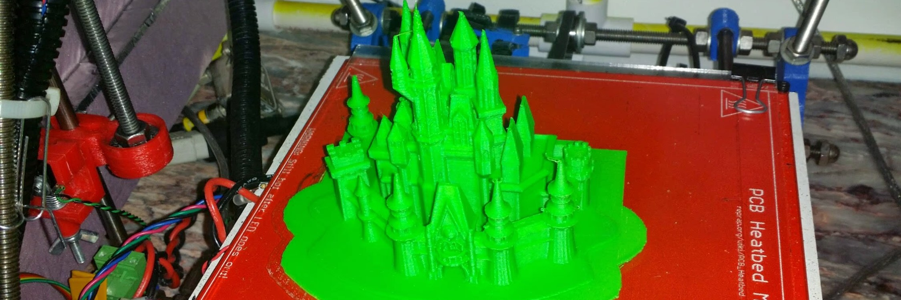

3D Printing
Digital Fabrication
Design and print your own 3D creations!
Take-home: Students keep their 3D printed creations
Space needed: Tables with computers and internet access
Notes: Computers with access to TinkerCAD.com and OnShape.com, and OrcaSlicer installed
Online: /programs/3d-printing/
3d-printing
LEVEL
TOPIC
LESSON
3rd Grade
Fractions, Area, & Perimeter
Design by the Numbers [3.MD]
Design a nameplate in CAD. Set the length and width, then calculate the area. Add a border and figure out the perimeter. Print it!
4th Grade
Geometry
Angle Design Challenge [4.G]
Design a ramp in CAD. Set the angle to 30, 45, and 60 degrees. Print each and race a marble down. Which angle wins?
5th Grade
Volume
Volume in Real Life [5.MD]
Design a container in CAD. Calculate the volume before printing. Does the printed piece hold exactly as much water as you calculated?
7th Grade
Geometry/Probability
Cross Sections [7.G]
Slice a 3D model and examine the cross section. Predict the shape before slicing. Design objects with specific cross-sectional geometry. Understanding conic sections is a little easier when you can hold them in your hand.
8th Grade
Functions/Geometry
Volume and Pythagorean Design [8.G]
Design a box with a diagonal brace. Use the Pythagorean theorem to calculate the brace length. Compute the volume, then print and verify.

Slide 26
3D Printing
Grade-level lessons (continued)
LEVEL
TOPIC
LESSON
Geometry
Geometric reasoning, proofs, transformations, and congruence
Transformations in CAD [G.CO]
Apply translations, rotations, and reflections to design parts in CAD software. Verify congruence between mirrored components. Print and test fit.
Geometry
Right triangle trigonometry, circles, volume, and surface area
Volume & Surface Area [G.GMD]
Design cylinders, cones, and spheres in CAD. Calculate volume and surface area from formulas before printing. Measure the finished piece and compare - how close is reality to the math?

Slide 27
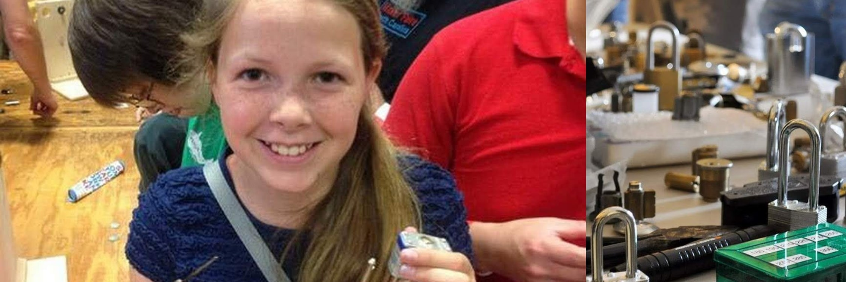

Lockpicking 101
Cybersecurity & Code
Understand physical security by learning how locks work!
Space needed: Tables and chairs
Online: /programs/lockpicking/
lockpicking
LEVEL
TOPIC
LESSON
4th Grade
Light, Sound, & Motion
Balanced Until It's Not [S4P3]
Feel the moment when a lock gives up. You're pressing the pins and turning the plug - the lock resists and then suddenly it doesn't. What changed about the forces inside at that instant?
8th Grade
Force/Energy
Torque vs. Friction [S8P3]
Apply steady torque on the plug while pressing each pin up in turn. The plug holds - until it doesn't. What forces were in equilibrium before that moment, and which one wins when the lock gives up?
Physics
Kinematics (motion), Newton's Laws, gravity, and energy
Free Body of a Pin Stack [SP2]
Draw the free-body diagram for a pin stack inside a locked cylinder: spring from above, pick force from below, friction and normal force from the walls. What configuration makes the torque on the plug non-zero? Why can't you pick the pins in any order?

Slide 28


Ethical Hacking Intro
Cybersecurity & Code
Learn cybersecurity through hands-on hacking challenges!
Space needed: Tables with computers and internet access
Online: /programs/ethical-hacking/
ethical-hackin
LEVEL
TOPIC
LESSON
Geometry
Geometric reasoning, proofs, transformations, and congruence
Boolean Logic [G.CO]
Apply AND, OR, NOT logic to crack challenges. Construct logical arguments. Boolean logic and Karnaugh maps train the same deductive habit as geometric proofs - each step justified by a rule you can name.
AP Statistics
Random variables, binomial/normal distributions, and statistical inference
Binomial Brute Force [S.MD]
Each guess has probability p of success. Use the binomial cumulative distribution function (CDF) complement to find how many tries give a 90% chance of cracking a PIN. The same calculation is why login lockouts and rate-limiting work.

Slide 29
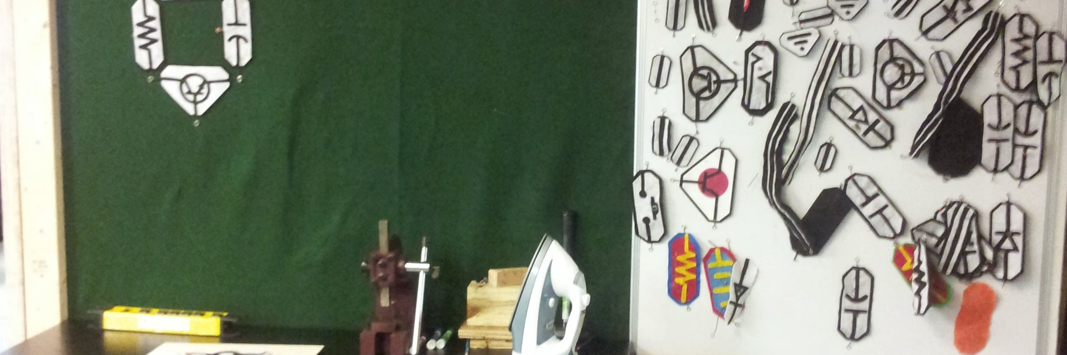

Hacker Mindset
Cybersecurity & Code
Ciphers, secret codes, and pattern-hunting for elementary students - the hacker mindset with no computers required.
Take-home: Cipher wheel + coded messages
Space needed: Classroom or multipurpose room with tables
Online: /programs/hacker-mindset/
hacker-mindset
LEVEL
TOPIC
LESSON
4th Grade
Multi-digit Multiplication/Division
Counting Combinations [4.NBT]
Start with a simple Caesar cipher made of just one decoder/cipher disk - it's 26 codes a kid can crack. Stack a second cipher disk, third, fourth - each disk multiplies the possibilities by 26. We'll do the math, then students can build their own. How many disks does it take to make it uncrackable?
5th Grade
Decimals & Order of Operations
Multi-Step Cipher [5.NBT]
Recreate a simplified ADFGVX cipher - the WWI German Army code that a French math teacher cracked mid-war. Substitute each letter on a grid, then scramble the result. Try every ordering, then encode a secret message for a friend to crack. Why does substitute-then-scramble give a different code than scramble-then-substitute?

Slide 30
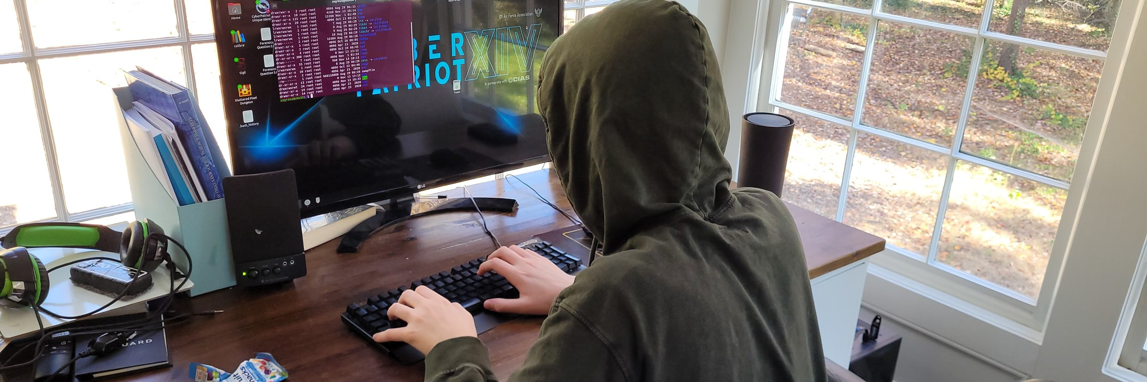

Cyber Sleuth
Cybersecurity & Code
Much of cybersecurity and nearly all of cryptography is a numbers game - math with numbers so large that computers can't manage them. Students explore those numbers at a scale they can see, watching them grow into territory no one can brute-force. They also poke at pre-built Capture-the-Flag puzzles and run a few eye-popping demos that feel like elite hacker moves while being completely benign. Nothing we do puts any real computer or network at risk before, during, or after this session.
Space needed: Tables with computers and internet access
Online: /programs/cyber-sleuth/
cyber-sleuth
LEVEL
TOPIC
LESSON
7th Grade
Geometry/Probability
Guessing Games [7.G]
A locked phone has a 4-digit PIN. A thief tries 1000 random PINs - what's the chance they get in? What if the PIN were 6 digits? Probability games and demos build the intuition for why longer PINs get harder fast.
8th Grade
Equations
Exponential Password Space [8.EE]
A 4-character password has a finite number of possible values. An 8-character one has more - not twice as many. Work the exponents. Now compare a short password with symbols and numbers to a much longer one that's all lowercase letters - which is actually harder to guess? Which classical ciphers make the best use of that same exponential expansion as the key grows? Test your answer in the Capture-the-Flag challenges.

Slide 31
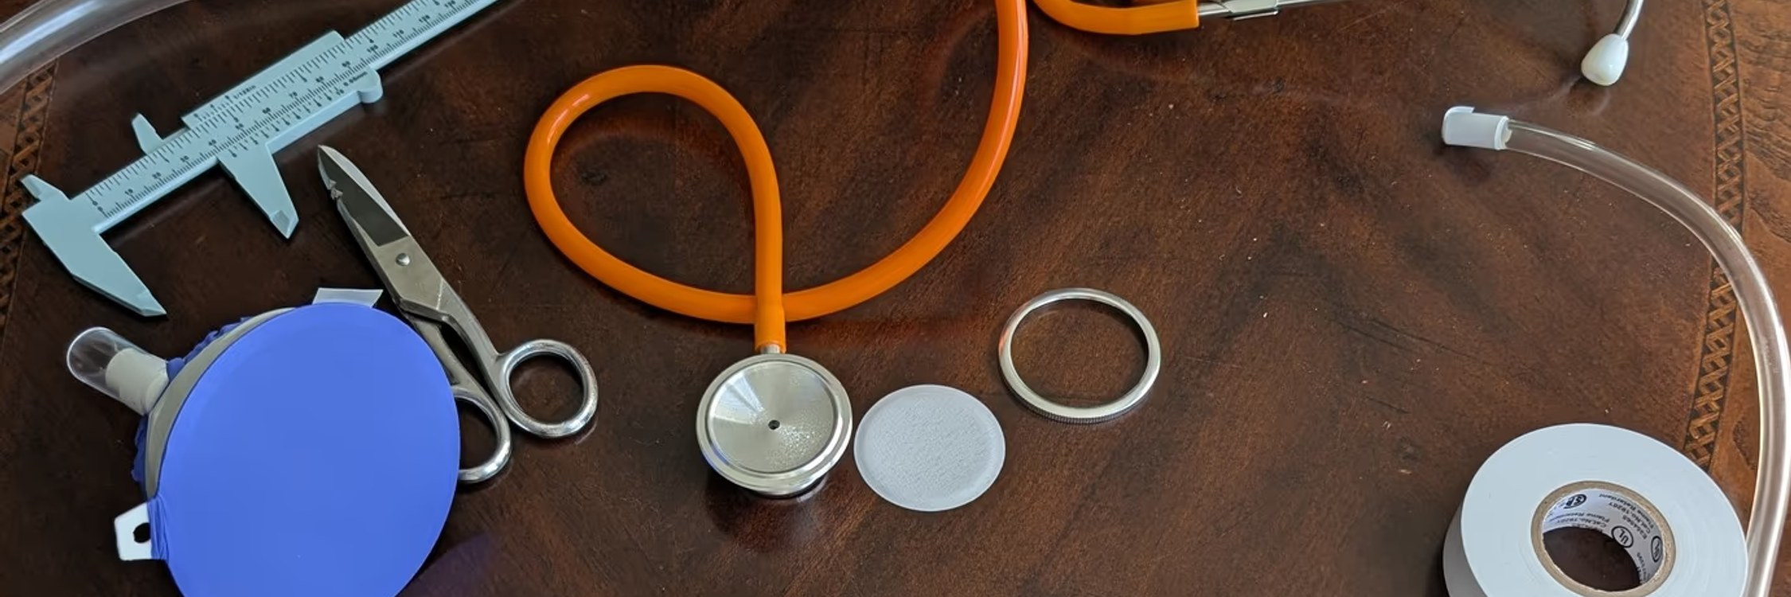

Listening with Tools
Science & Discovery
Build a real stethoscope from recycled materials and 3D printed parts, then solve sound mysteries!
Take-home: Students keep their stethoscopes
Space needed: Classroom or multipurpose room with tables
Online: /programs/sound-detectives/
sound-detectiv
LEVEL
TOPIC
LESSON
Pre-K
Intro to STEM
Mystery Box Sounds
Mystery box challenge: press a stethoscope against the box and figure out what's hiding inside by sound alone. What can you hear with the stethoscope that you can't hear without it? Your heart thump, a clock tick, water moving through a pipe in the wall?
1st Grade
Weather; Light & Sound
Build a Stethoscope [S1P1]
Build a working stethoscope from tubes and funnels. Listen to heartbeats, ticking clocks, and whispers. How does sound travel through the tube?
1st Grade
Light & Sound; Magnets
Sound Mystery Walk [S1P1]
After building stethoscopes from tubes and funnels, take them on a listening tour. Can you hear through the wall? Through the desk?
4th Grade
Light, Sound, & Motion
Sound Travels Through... [S4P2]
Build stethoscopes, then press them against air-filled, water-filled, wood, and metal samples. Compare how well sound transmits through each medium. Rank the materials.

Slide 32
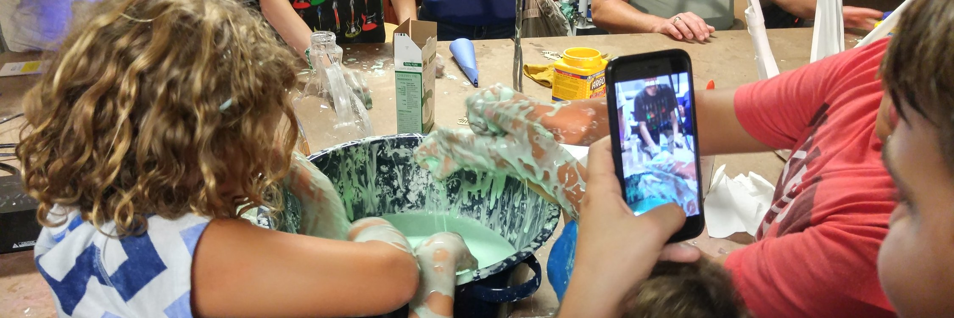

Non-Newtonian Fluids - Oobleck
Science & Discovery
Is it a liquid or a solid? BOTH! Mix oobleck, watch it dance on a speaker, then run across a giant trough of it!
Take-home: Recipe card to make more at home
Space needed: Indoor or outdoor space, tables for mixing
Online: /programs/oobleck-adventure/
oobleck-advent
LEVEL
TOPIC
LESSON
Pre-K
Intro to STEM
Liquid AND Solid
Mix cornstarch and water and watch it act like a liquid AND a solid at the same time! Squish it, run across it, then watch it dance on a speaker.
2nd Grade
Forces; Matter & Physical Changes
States of Matter Breaker [S2P1]
After sorting other materials into solids and liquids, mix oobleck and try to sort it - it breaks the rules! Can something be solid AND liquid?
2nd Grade
Matter & Physical Changes
Dancing Oobleck [S2P1]
Place oobleck on a speaker and watch it dance! Sound waves create vibrations that make the non-Newtonian fluid jump and form shapes.
5th Grade
Electricity, Magnetism, & Chemistry
Physical or Chemical? [S5P1]
Mix cornstarch and water - is it a physical or chemical change? Test: can you separate them again? Compare to baking soda + vinegar (chemical!).
6th Grade
Ratios
Ratio Recipe Lab [6.RP]
Change the cornstarch-to-water ratio (1:1, 2:1, 3:1). Which ratio makes the best oobleck? Graph viscosity vs. ratio. Find the sweet spot.
7th Grade
Numbers/Equations
Rational Recipe Math [7.NS]
Scale the oobleck recipe up and down using rational numbers. Convert between cups, ounces, and grams. What happens at a 3:2 ratio vs. 1:2?

Slide 33
Non-Newtonian Fluids - Oobleck
Grade-level lessons (continued)
LEVEL
TOPIC
LESSON
8th Grade
Matter/Chemistry
Non-Newtonian Fluid Analysis [S8P1]
Investigate viscosity as a property of matter. Why does oobleck resist sudden force? Explore shear-thickening.
Chemistry
Atomic structure and chemical bonding
Intermolecular Forces [SC4]
Why does oobleck behave differently under force? Explore how polymer chain entanglement creates non-Newtonian behavior at the molecular level.

Slide 34
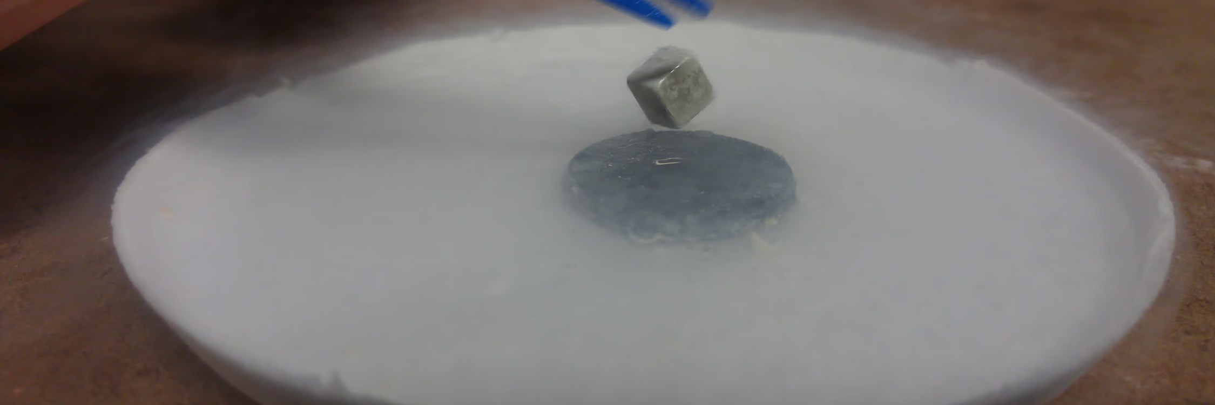

Magnet Explorers
Science & Discovery
Discover the invisible force! Build an electromagnet, explore magnetic fields, and play with floating magnets and ferrofluid.
Take-home: Magnet kit
Space needed: Classroom or multipurpose room with tables
Online: /programs/magnet-explorers/
magnet-explore
LEVEL
TOPIC
LESSON
Pre-K
Intro to STEM
Magnetic Wand Hunt
Wave a magnetic wand around the room and find what sticks! Aluminum foil looks like metal but it won't stick. Some coins stick and some don't. Surprises everywhere.
Kindergarten
Counting & Sorting
Ferromagnetic Sort [K.MD]
Test everything with a magnetic wand. Sort everything into two piles: things that stick, and things that don't. The puzzle: aluminum foil looks like metal but doesn't stick, and only some coins do. Count each pile - which is bigger?
1st Grade
Light & Sound; Magnets
Attract or Repel? [S1P2]
Test magnetic wands on classroom objects. Make a chart: "sticks" vs. "doesn't stick." Discover poles - push together or pull apart!
5th Grade
Electricity, Magnetism, & Chemistry
Electromagnet Builder [S5P3]
Wind wire around a nail and connect to a battery - you made an electromagnet! More coils = stronger magnet. Discover the electricity-magnetism connection.
8th Grade
Force/Energy
Meissner Levitation [S8P5]
Pour liquid nitrogen on a YBCO ceramic disk and watch a magnet float above it - the Meissner effect. Spin it like a top, push it down to feel the springback, try to lift it off - some motions are free, others fight you. Try copper at the same temperature - no levitation. Why does this only work cold?

Slide 35
Magnet Explorers
Grade-level lessons (continued)
LEVEL
TOPIC
LESSON
Physics
Waves, sound, light/optics, electricity, and magnetism
Field Mapping [SP5.e]
Map magnetic field lines with iron filings and a compass. Use a smartphone magnetometer to measure field strength at different distances. Verify the inverse-cube relationship.

Slide 36
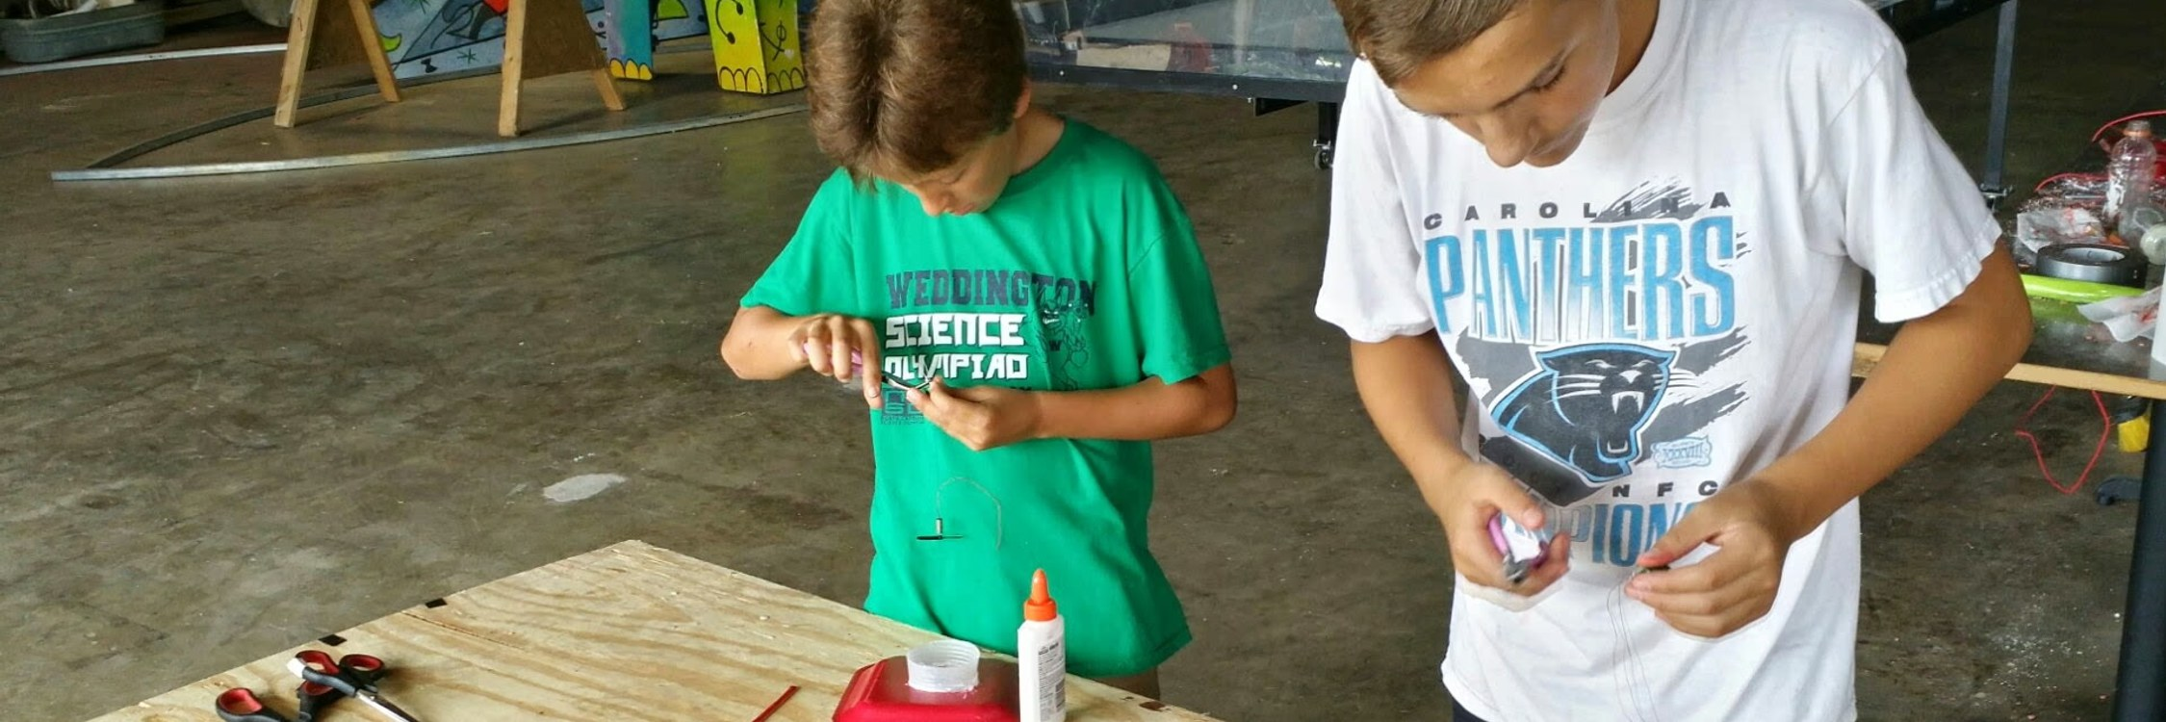

Paper Plate Speaker
Science & Discovery
Wind copper coils, connect magnets, and build a real working speaker from a paper plate!
Take-home: Working speaker + hand-wound coil
Space needed: Tables
Online: /programs/paper-plate-speaker/
paper-plate-sp
LEVEL
TOPIC
LESSON
4th Grade
Light, Sound, & Motion
Pitch and Volume [S4P2]
Change the song's pitch and volume. Watch the speaker plate move more or less. Louder = bigger vibrations. Higher pitch = faster vibrations.
5th Grade
Electricity, Magnetism, & Chemistry
Electromagnet Sound [S5P3]
Your speaker IS an electromagnet! The coil creates a changing magnetic field that moves the plate. Electricity becomes magnetism becomes motion becomes sound. We will manipulate the electricity and see how the magnet responds and change the frequency until we can no longer see... but only hear it.
8th Grade
Force/Energy
Passive Telephone and Timbre [S8P4]
Wire two speakers together, coil to coil - no battery, no amp. Tap the plate of one and the other plate jumps: the physics that drives a speaker also reads it back. Now drive your speaker with a sine wave and a square wave at the same pitch. Same frequency, different sound - why?
Physics
Waves, sound, light/optics, electricity, and magnetism
Wave Mechanics [SP4] [SP5.e]
Measure frequency and amplitude of your speaker's output. Calculate wavelength. Demonstrate the relationship between electromagnet current and sound amplitude.

Slide 37
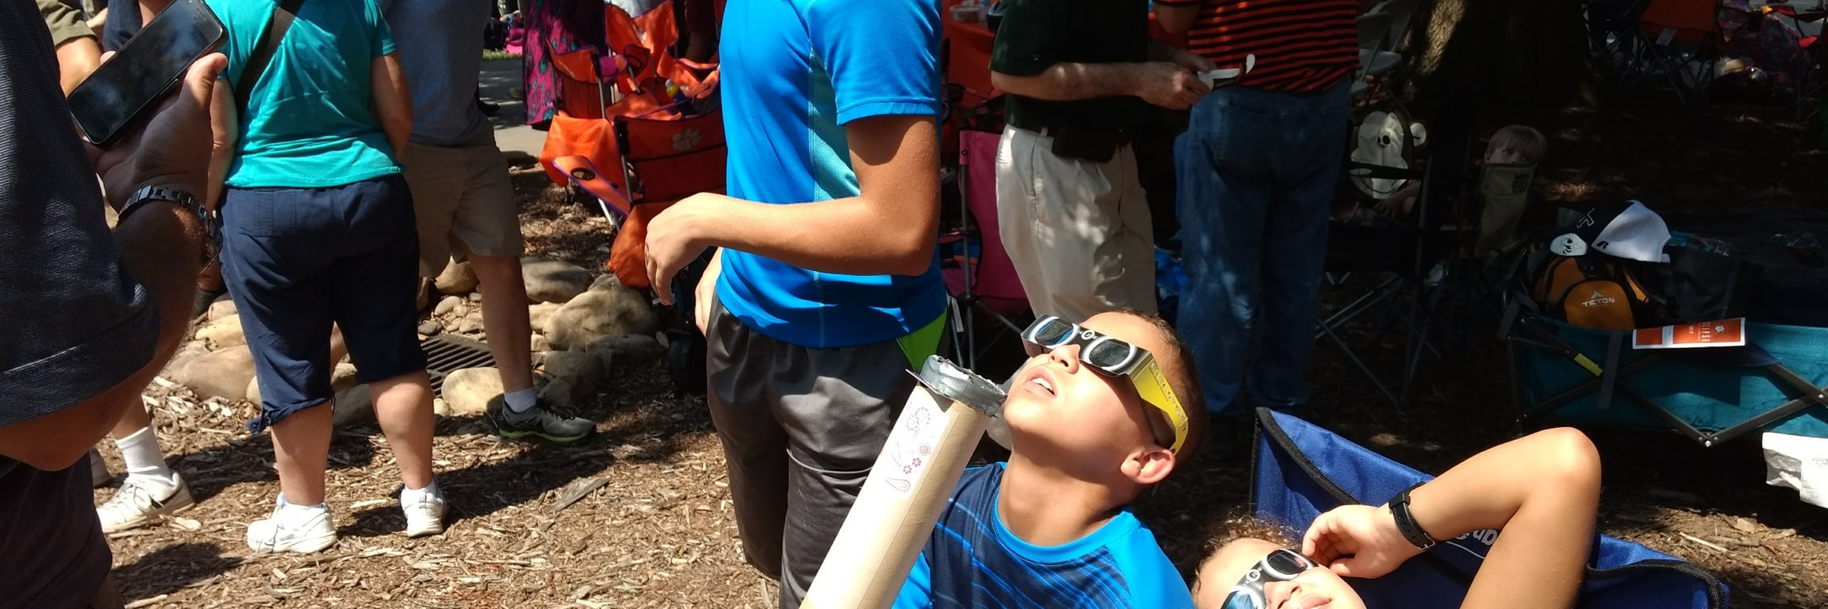

Diffraction Grating Glasses
Science & Discovery
Build spectroscope glasses and see the hidden rainbow inside every light source!
Take-home: Spectroscope glasses + diffraction grating film
Space needed: Any classroom with multiple light types
Online: /programs/diffraction-grating-glasses/
diffraction-gr
LEVEL
TOPIC
LESSON
1st Grade
Weather; Light & Sound
Light Detectives [S1P1]
Look at different lights through spectroscope glasses: LED, halogen, fluorescent, neon. Which makes a full rainbow? Which shows only a few bright colors?
4th Grade
Light, Sound, & Motion
Light Spectrum Analysis [S4P1]
Compare the spectra of incandescent, fluorescent, and LED lights. Why do they look different? Explore how light bends through the diffraction grating.
8th Grade
Force/Energy
Electromagnetic Spectrum [S8P4]
Use diffraction gratings to observe visible light spectra. Where does visible light sit on the full EM spectrum, and what lies just past what your eye can see?

Slide 38
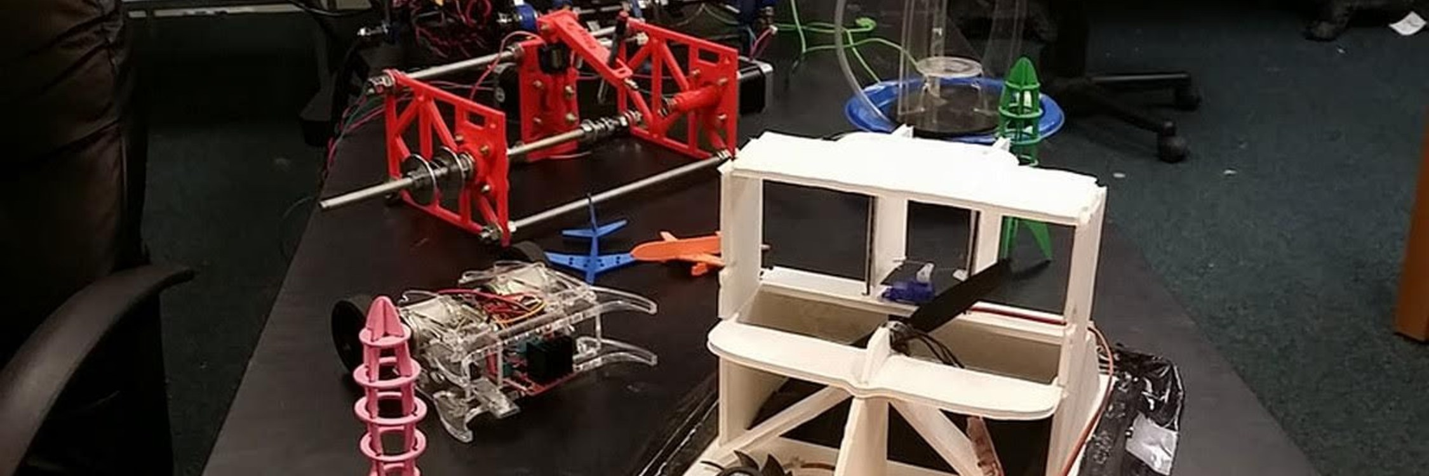

Weather Station
Science & Discovery
Build real weather instruments and become your own meteorologist.
Take-home: Students keep the instruments they build
Space needed: Classroom or multipurpose room with tables
Online: /programs/weather-station/
weather-statio
LEVEL
TOPIC
LESSON
Pre-K
Intro to STEM
Watch It Move
Build a thermometer and watch the line go up when it's warm and down when it's cold. Build an anemometer and watch the cups spin in the wind - or blow on it and make it spin yourself!
1st Grade
Weather; Light & Sound
Temperature Tracker [S1E1]
Build a thermometer and check it daily. Is today warmer or cooler than yesterday? Track patterns on a class chart.
1st Grade
Measurement, Time, & Geometry
Read the Ruler [1.MD]
Build a rain gauge and read the water level in inches. Measure wind speed by counting spins. Practice reading scales and rulers.
2nd Grade
Measurement, Money, & Shapes
Measurement Day [2.MD]
Build a rain gauge and a thermometer. Measure rainfall in inches and temperature in degrees. Compare today to yesterday - warmer? More rain? Record on the class chart.
4th Grade
Multi-digit Multiplication/Division
Data Computation [4.NBT]
Build student-made thermometers, barometers, and anemometers. Read each instrument daily, then use multi-digit arithmetic to calculate highs, lows, ranges, and averages for the week.
6th Grade
Ratios
Data Ratios [6.RP]
Build a barometer and thermometer from straws, water, and a jar. Log readings hourly, then compute rate-of-change ratios (degrees per hour, millibars per hour). Use the ratios to predict incoming fronts.

Slide 39
Weather Station
Grade-level lessons (continued)
LEVEL
TOPIC
LESSON
6th Grade
Water/Weather
Climate Data Collection [S6E4]
Build instruments and collect multi-day data sets. Compare your school's microclimate to official weather reports. What factors cause differences?
AP Statistics
Data exploration, sampling, experiments, and probability
Sampling Design [S.ID]
Build instruments, then design a data collection protocol: sampling frequency, station placement, and controls for bias (sun exposure, proximity to buildings). Analyze the resulting dataset for trends and outliers.
AP Statistics
Random variables, binomial/normal distributions, and statistical inference
Two-Sample Testing [S.IC]
Build an Arduino thermometer sensor array. Record morning and afternoon temperatures for 30 days. Run a two-sample t-test on your own measurements - is the AM/PM difference statistically significant, or just sample noise?
Earth Systems
Hydrosphere, atmosphere, weather systems, and climate
Atmospheric Data Collection [SES5]
Build a barometric pressure monitoring station with a Raspberry Pi and barometer. Collect two weeks of data. Correlate barometric drops with incoming fronts. Present findings like a professional meteorologist.
AP Environmental Science
Land/Water use, Energy resources, Atmospheric pollution, and Global change
Atmospheric Monitoring [APES Unit 9]
Build a student-operated multi-instrument weather station and log long-term atmospheric data with a Raspberry Pi and an assortment of sensors. Compare your local readings to NOAA regional trends. Discuss how human activity reshapes air quality and climate.

Slide 40

Mobile STEM Workshops for Schools
makerlabkids.com
info@MakerLabKids.com
Metro Atlanta - Free travel within 30 miles

